Slide 1

66th General Service Conference
Crowne Plaza Times Square
New York, NY 10019
April 17 – April 23, 2016
Pat F.
Panel 65 Delegate
Area 59 ~ Eastern Pennsylvania
Delegate@Area59aa.org

Slide 2
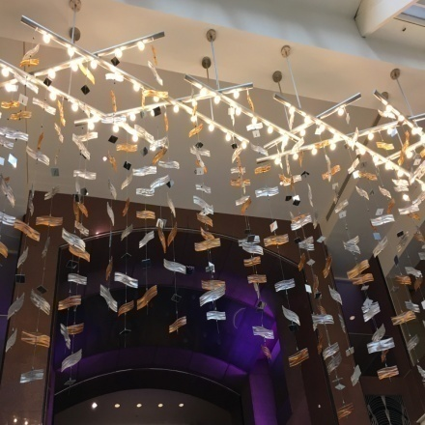
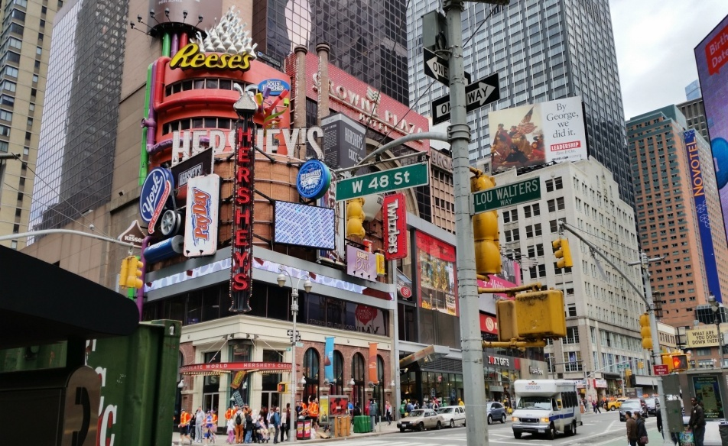

Crowne Plaza Times Square
New York, NY 10019
Notes:
This is where it took place. Bustling part of New York. View looking up in the lobby.

Slide 3
Delegate’s Conference Report
Mini Assembly
What I saw, heard, and felt
What it was like: The preparation
What happened: The Conference Experience
What it is like now: Agenda Recommendations and Additional Considerations
Notes:
Slide 3

Slide 4
PANEL | DELEGATE | PANEL | DELEGATE
01 | George R. (1951-52) | 33 | Dorothy G. (1983-84)
03 | Aaron B. (1953-54) | 35 | Robert N. (1985-86)
05 | Richard C. (1955-56) | 37 | William G. (1987-88)
07 | Horace H. (1957-58) | 39 | Reba W. (1989-90)
09 | Ed H. (1959-60) | 41 | Marcia G. (1991-92)
11 | Ted R. (1961-62) | 43 | Hugo McK. (1993-94)
13 | Paul O. (1963-64) | 45 | Joe Q. (1995-96)
15 | Gail J. (1965-66) | 47 | Clay R. (1997-98)
17 | Louis R. (1967-68) | 49 | Gary C. (1999-2000)
19 | Monroe B. (1969-70) | 51 | Martin S. (2001-02)
21 | Lenore M. (1971-72) | 53 | Nancy K. (2003-04)
23 | Joseph DeB. (1973-74) | 55 | J. Gary L. (2005-06)
25 | Francis G. (1975-76) | 57 | Sheila D. (2007-08)
27 | Lenore J. (1977-78) | 59 | Lowell L. (2009-10)
29 | Ambrose M. (1979-80) | 61 | Hugh H. (2011-12)
31 | Lee B. (1981-82) | 63 | Steve O. (2013-14)
Area 59 Delegates to the
General Service Conference
of Alcoholics Anonymous
Beginning in 1951 to present
Notes:
My thanks to all those who came before me and helped me with my journey as Delegate. I am eternally grateful!

Slide 5
Notes:
Slide 5

Slide 6
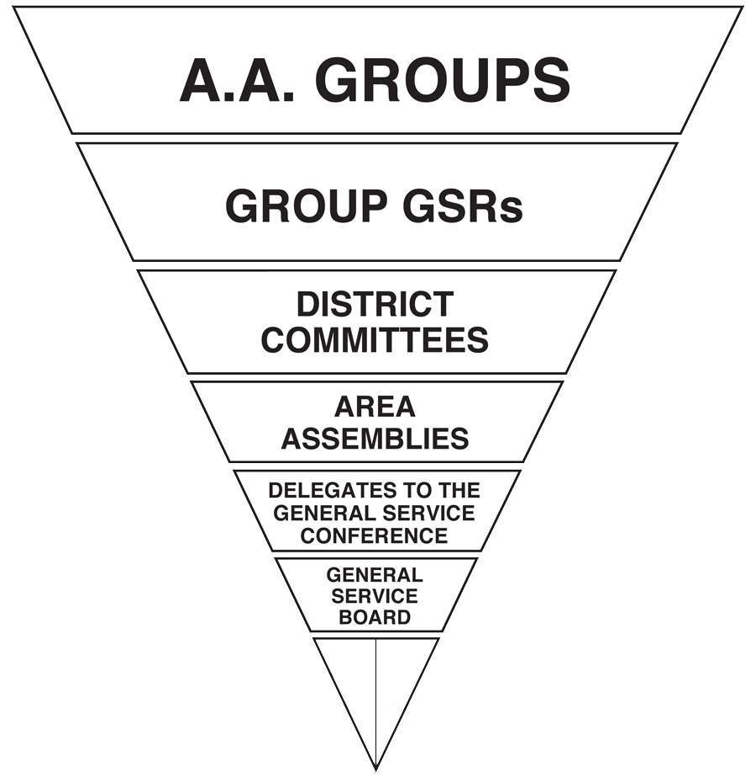
Structure of the Conference
(U.S. and Canada)
Services
A.A.W.S.
BOARD
A.A.
GRAPEVINE
BOARD

Slide 7
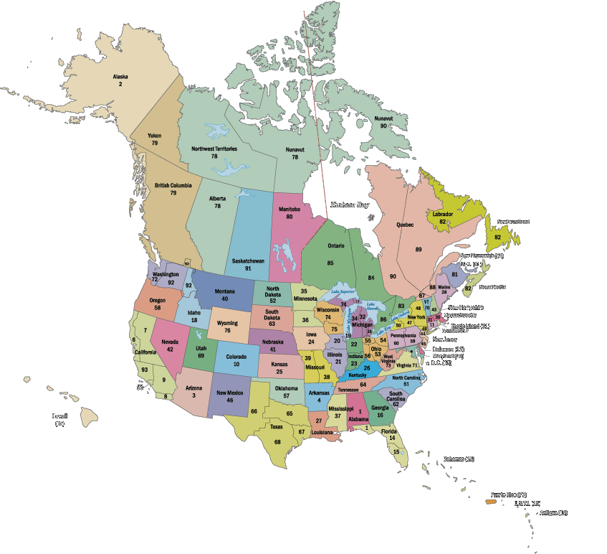

Who Makes Up The General Service Conference?
69.4%
93 Delegates
25 Trustees, A.A.W.S. Directors, GV Directors
18.7%
16 GSO and GV Staff
11.9%
Every Conference member has not only a vote but a voice; not only a right but a responsibility to express his or her views.

Slide 8
STATISTICS ON DELEGATES
Years
Average Age 57
Oldest 76
Youngest 33
Average Length of Sobriety 22
Longest Sobriety 50
Shortest Sobriety 9
Average Length of Service 17
Longest Service 49
Shortest Service 6

Slide 9
Weekly Schedule
Friday, Arrived in NY via Sheila D, Past Delegate Panel 57 (Area 59 Tradition)
Saturday, Early tour of Stepping Stones, Bill and Lois home , lunch with Delegates, Reception upon return, 1728 Meeting, Remote Communities Meeting, Delegates Only Meeting **
Addressed all Delegates at Sat. evening Meeting, followed by Mass at Actors Chapel across the street from hotel
Sunday Roll Call** Welcome Remarks, Presentations, Nebraska Delegate Motion, NERD Luncheon with NERT, First Report and Charter Committee meeting, Opening Dinner with Guest Donald H, Archivist. First NERD walk

Slide 10
Weekly Schedule
Monday – Wednesdays – Report and Charter Committee Meetings
Wednesday – Moderated Workshop on Structure - Voting Began
Thursday – Elections and Full Conference Committee Reports – Voting continued (6:30 AM – 10:30 PM)
Friday – Completed Conference Advisory Actions, Committee Considerations and Floor Actions, Panel 65 Goodbyes, Serenade
Saturday – Brunch, Rotating Trustees, Farewells
A humble, grateful heart!!
Area 59 Tradition, Hugh H., Past Delegate Panel 61 picked me up and delivered me to my door!

Slide 11
Weekly Schedule (9am-9pm+)
Early Session – Saturday
1728 Meeting
Remote Communities
Delegates Only Meeting
Monday – Friday
Committee meetings
Presentations
Election of New Trustees
Committee reports-back
Opening Day - Sunday
Roll call
Keynote addresses
Trustees & R & C Committee
GSB Dinner
Closing Day – Saturday
Closing Brunch
Rotating Trustees
Goodbyes
Past Delegate pick up (Area 59 Tradition)

Slide 12
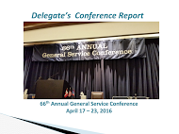
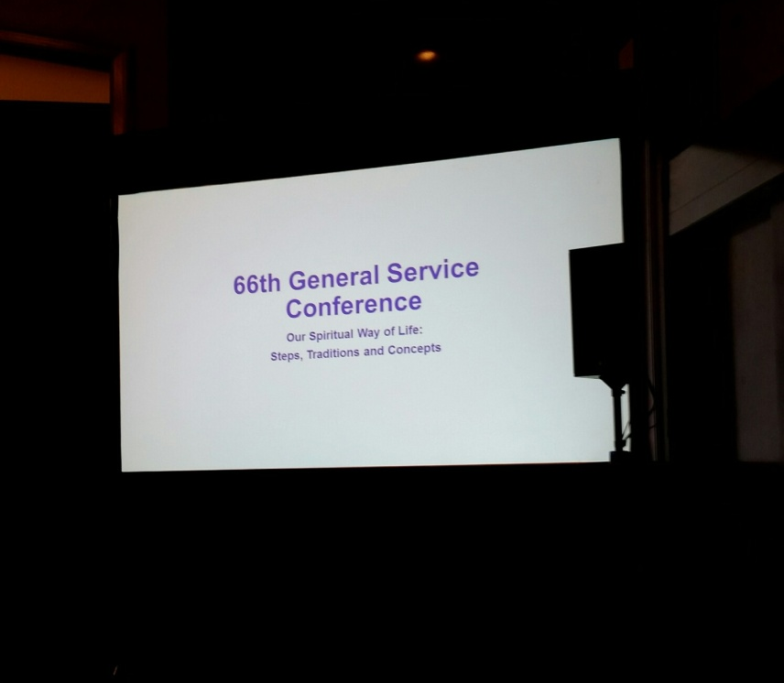
This is the view from where we sat and experienced AA at its finest! The stage and the screen.

Slide 13
General Service Board Report
Met quarterly since 2015 Conference
Hosted six Regional & Local Forums in 2015
New General Manager, Greg Tobin
Major focus on Strategic Planning
Serving the Fellowship

Slide 14
General Service Board Report
Long range planning issues to watch:
  Finance:
    Self-support
    Impact of the move toward digital
    Long term stability
  Lack of growth in the Fellowship
  Decline in literature sales and subscriptions
  Social media and anonymity

Slide 15
AAWS Board Report
Provides Oversight of G.S.O. group services, A.A.W.S. Publishing and translations, and owns copyrights
G.S.O.: 79 employees; welcomed 1,694 visitors in 2015
New Groups listed in US & Canada in 2015: 1,195
Website: 12,793,449 visits - - 35% increase; “What’s New”
Big Books sold: 792,768 - - down from 1,308,238 in 2014
eBook Gross Sales in 2015: $244,132 (62,411 units sold)
Publishing – sales $12,706,249, which is $2,113,751 below estimate (14% negative variance)
2016 Budget approved with a net loss of $26,691

Slide 16
AAWS Board Report (contd)
Big Book available in 69 languages
EBooks: 64% Kindle; 13% Apple and 5% Nook
International Licensing Requests
Largest International Convention to date in Atlanta
2015 contributions: (2% over budget, up 3.71% from 2014)
2015 Three Major Initiatives

Slide 17
AA Grapevine Board Report
Distributed 103,193 GV & La Vina books, CDs and other items
La Vina launched opt-in texting
Circulation – GV: 71,966 (2,034 subs below 2014) La Vina: 10,350 (116 below 2014)
GV Online – averaged 5,233 subscribers
Daily Quote – 39,368
Financial: net income of $245,204, against budgeted net loss of $14,614
Continued cost control measures in place

Slide 18
AA Grapevine Board Report
Aagrapevine.org - -
premiere connection with the Fellowship
Majority of subscriptions/purchases occur online
Digital communications - - effective & cost saving
About 25% of AAGVs online subscribers opt for both online services and print magazine
Mirror of the membership
Additional subscribers required for GV & La Vina to continue into the future

Slide 19

Introducing the new Grapevine
Subscription
App
Subscribers receive:
- The monthly issue
- Access to past issues as of the beginning of the magazine app subscription
- Notices from GV
- Option to email an article to a friend
- Enabled for audio stories and featured videos
For downloadable offline viewing
(without internet connection)
Tablet or smartphone enabled
iOS, Android Microsoft 10 & Amazon Kindle Fire

Slide 20
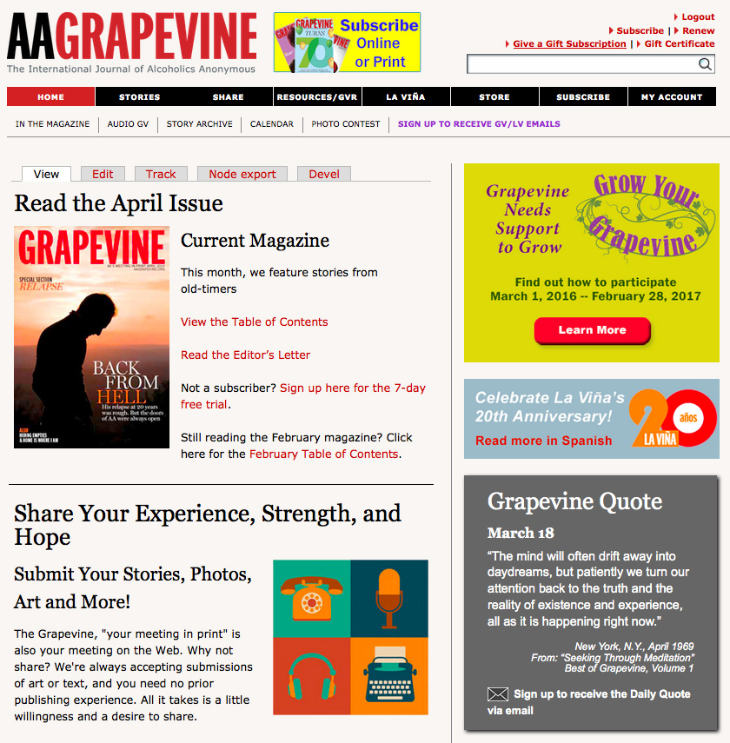
REGIONAL PAGES
East Central
Eastern Canada
Northeast
Pacific
Southeast
Southwest
West Central
Western Canada
Coming soon: Winter 2016
Notes:
Slide 16

Slide 21
Finance Presentation - - Around the Picnic Table
Increase communication to the fellowship on the importance of supporting services we are requesting
Spiritual value of contributing
As print sales decline, vital the Fellowship fully embrace the 7th Tradition
Expenses climbing 2-3% per year
Get the word out to those who are not contributing
Of the 40% of groups contributing, 80% contribute regularly
Full report will be posted on Area59aa.org

Slide 22

1935 - $1.00
A Dollar is Not What It Used To Be
Remember inflation when deciding upon your
7th Tradition
Self-Support
Contributions for:
- Group Meetings
- Birthday Gifts
- Gratitude Month
1935
$1.00
2016
$13.00
2016 - $13.00
Illustrates the very pervasive and negative effects of how inflation has diminished the
value or purchasing power of $1 since the very first days of AA through today.

Slide 23
General Service Board showed a net income of $205,625
Grapevine was in the black for another year with $245,204, while LaVina’ costs exceeded income by ($146,378)
General Service Board ~ Reserve Fund: 10.2 months on 12/31/15
Financials Overall: Our GSB, AAWS, Inc. and AAGV, Inc.

Slide 24
GENERAL SERVICE BOARD
FINANCIAL SUMMARY OF OPERATIONS 12-31-15
 | G.S.O. GENERAL FUND | A.A.W.S. PUBLISHING
REVENUE
Net Sales |  | $12,489,433
Contributions | $7,154,146
Interest | 43 | 391
TOTAL REVENUE | 7,154,189 | 12,489,824
EXPENSES
Printing |  | 2,737,914
Royalties |  | 19,078
Shipping & Warehouse |  | 1,562,057
Program Expenses | 6,872,852 | 2,976,629
Supporting Services | 2,756,647 | 2,513,211
TOTAL EXPENSES | 9,629,499 | 9,808,889
NET INCOME (LOSS) OPERATIONS | (2,475,310) | 2,680,935
$205,625

Slide 25
Self-Support Bottom Line
General Service Board showed a Net Income of $205,625; 2014 = $1,376,656
Percentage of services supported by Seventh Tradition Dollars was 74.3%
Shortfall between costs of services and amount of contributions in 2015 was $2,475,310
Significant concern as projected publishing income decreases into the future

Slide 26
MEMBER SERVICES & STATISTICSMemberMember Services Statistics
 | 2015 | 2014 | 2013
Number of Members | 1,348,072 | 1,373,497 | 1,389,602
Cost of Services per Member | $7.14 | $7.08 | $6.84
7th Tradition Self-Support Contributions per Member | 5.24 | 5.02 | 4.97
Cost of Services NOT covered by Self-Support | $ 1.90 | $ 2.06 | $ 1.87
Number of Groups | 65,741 | 65,222 | 64,694
Cost of Services per Group | $146.48 | $149.11 | $146.96
7th Tradition Self-Support Contributions per Group | 108.82 | 105.76 | 106.75
Cost of Services NOT covered by Self-Support | $ 37.66 | $ 43.35 | $ 40.21
Percentage of Groups Contributing | 40.30% | 41.60% | 42.50%
Number of Groups that Contributed | 26,500 | 27,103 | 27,841

Slide 27
Percentage of Groups Contributing 2006- 2015 40.3% (26,500 groups out of 65,741 total) compared to 41.0% that contributed in 2014

Slide 28
7th Tradition Self-Support ~ 1996-2015

Slide 29
GSO/AAWS
  Membership levels are flat
  Contributions show little growth
  Literature sales show slow to no growth
  Expenses continue to grow slowly – 2% - 3% per year
BUDGET OUTLOOK AND TRENDS

Slide 30
GRAPEVINE
Subscriptions continue to decline 2% - 3% per year
Expenses continue to grow slowly 2% - 3% per year
BUDGET OUTLOOK AND TRENDS

Slide 31
2016 Budget Outlook
GSO/AAWS, Grapevine, and La Viña combined budgeted results is $325,600 loss, with following years having even larger losses, assuming no changes in operations fellowship wide.
Projected loss 2017 = ($861,800)
2018 = ($1,447,800)
BUDGET OUTLOOK AND TRENDS

Slide 32
Area 59 Challenge

Slide 33
A.A. belongs to the Groups. Are we going to support it ??

Slide 34
Feasibility Study
Improving Internal and External Communications
Ideas for Increasing Revenues
Ideas for Reducing Expenses
Ideas on Organizational Structure

Slide 35
Trustee Elections and Regional Business
West Central Regional Trustee – Thomas A.
Western Canada Regional Trustee – Cate W.
2017
Feb 24 - 26 - NERAASA - Framington, MA (Area 30) www.neraasa.org
June 2 - 4 - Northeast Regional Forum (NERF) - Mars, PA (Area 60) http://www.aa.org
Notes:
Strategically placed among more intense sessions like...to prevent flame-out…
Segue: “Remote Communities…”

Slide 36
The Group Conscience of A.A. as a Whole ~ Our Spiritual Handshake
  Conference Committee Structure
  Delegate Conference Committees
    Composed of Delegates who “meet early in the week” (p S-56)
    “Do the principal work of the Conference” (p S-56)
  Trustee Committees
    “Meet quarterly” (p S-70)
    “Often form subcommittees to work on specific projects” (p S-70)

Slide 37
What is an Advisory Action?
Conference Advisory Actions represent recommendations of the Conference committees, or floor actions that have been approved by the Conference body as a whole with substantial unanimity (2/3 vote).
Advises the Trustees how “we” want them to serve the Fellowship
(page S58 of The A.A. Service Manual, 2015-2016 edition)

Slide 38
Additional Committee Considerations
Advisory Action 40 of the 1990 General Service Conference states: “Items discussed, but no action taken or recommendation made, as well as committee recommendations which are not adopted, be included in a separate section of the Final Report.”

Slide 39
2016 General Service Conference Committee Agenda Items
Advisory Actions and Additional Considerations from the 66th General Service Conference

Slide 40
I. Agenda 2017 67th General Service Conference Agenda
Conference Theme: “Supporting Our Future”
Growth:
a) Diversity: Outreach and Attraction
Safety – An Important Consideration
Communication – Today and Tomorrow
Participation:
Fellowship vs Membership
Leadership: I am Responsible…”
Is Your Voice Heard?
Contributions:
Spirituality and Money
Fully Self Supporting Our Obligations
Apathy and Power of the Purse!

Slide 41
II. Cooperation with the Professional Community
Consider discontinuing the pamphlet “Three Talks to Medical Societies by Bill W.”
Committee Considerations:
The committee considered a request to discontinue the pamphlet “Three Talks to Medical Societies by Bill W.” and took no action. The committee noted that the information in the pamphlet was outdated and did not accurately or appropriately describe the A.A. program of recovery for C.P.C. use, but agreed that the pamphlet may have value to A.A. members as a marker of historic A.A. moments. In light of this, the committee suggested the trustees’ C.P.C./Treatment/Accessibilities committee continue to discuss the value of keeping this pamphlet available to the Fellowship.

Slide 42
II. Cooperation with the Professional Community
B. Consider adding text regarding A.A. and medications to the pamphlet “If You are a Professional…”
Advisory Action:
A new section on A.A. and medications be added to the pamphlet “If You are a Professional…” with the following text:
A.A. Members and Medications
A.A. does not provide medical advice; all medical advice and treatment should come from a qualified health care professional. The suggestions provided in the pamphlet “The A.A. Member—Medications and Other Drugs” may help A.A. members minimize the risk of relapse.

Slide 43
II. Cooperation with the Professional Community
C. Consider adding text to the pamphlet “Is there an Alcoholic in the Workplace?” regarding A.A. as a resource for small businesses.
Advisory Action:
Text be added to the last paragraph of the first page of the pamphlet “Is there an Alcoholic in the Workplace?” to read (additions in bold):
A.A. can help organizations, corporations and businesses, regardless of size, contact men and women who have achieved sobriety, and are willing to share their experience freely with anyone who seeks help

Slide 44
III. Corrections
The video to replace “It Sure Beats Sitting in a Cell” with the title, “A New Freedom.”
B. Discuss the Corrections Correspondence Service (C.C.S.).
Committee Considerations:
The committee discussed the Corrections Correspondence Service (C.C.S.). They reviewed some of the challenges of expanding C.C.S. in Canada, offered insights, and were grateful to note that the trustees’ Committee on Corrections continues to explore solutions.

Slide 45
III. Corrections
The committee also discussed ways to attract more Spanish-speaking “outside” A.A. members to correspond with Spanish-speaking inmates in order to fill the current need. The committee offered two suggestions for Area Delegates:
    Encourage members of Spanish linguistic districts to participate in Corrections Correspondence Service.
    Ask members involved with C.C.S. to write articles for Grapevine and La Viña sharing their experience.
The committee suggested that two items be added to the form “Corrections Correspondence Service – a Special Kind of A.A. Service” (F-26):
A note that a member need not have been incarcerated to be a correspondent.
A space where “outside” members can indicate if they are able to correspond in more than one language.

Slide 46
IV. Finance
Review suggested area contribution for delegate expense for the Conference.
    Took No Action
B. Review the Conference approved level of $5,000 for individual bequests to the General Service Board from A.A. Members.
    Took No Action

Slide 47
IV. Finance
C. Review the Conference approved maximum annual contribution to the General Service Board from an individual A.A. Member of $3,000.
Took No Action
D. Discuss material from A.A.W.S. Self-Support Committee.

Slide 48
IV. Finance
Committee Considerations:
The committee received and discussed information from the A.A.W.S. Self-Support Subcommittee, and considered the format and use of the flyer “The Seventh Tradition Fact Sheet” (F-203). The committee suggests that the office consider additional ways to convey the financial message using technology. One suggestion was offered to create a PowerPoint presentation of the flyer The Seventh Tradition Fact Sheet” (F-203) and make it available for download.

Slide 49
IV. Finance
Committee Considerations:
The committee suggests adding the F-203 piece to the Self-Support Packet (F-19) and the Birthday Plan Envelope to the F-19 packet and removing various items such as the eight-page document entitled “Services Provided by G.S.O./A.A.W.S.” and the “Historical Background of Self-Support“ piece with consideration given to the attached flyers and posters.

Slide 50
IV. Finance
Committee Considerations:
The Conference Finance Committee requests that the General Service Board/A.A.W.S. consider measures that would assure that all future International Conventions are self-supporting through registration activities. The G.S.B./A.A.W.S. might consider the feasibility of a separate ongoing Convention Fund, transportation requirements, hotel accommodations, cut-off dates, and other appropriate items.

Slide 51
IV. Finance
Committee Considerations:
The committee suggests the General Service Board consider the spiritual message of self-support in our spending priorities when dealing with items such as World Service Meeting and related activities.
In addition to the above actions and suggestions, the committee had a long discussion about better communication of information within the Fellowship concerning financial matters.

Slide 52
V. Grapevine
It was recommended that the Delegate Chair to the Grapevine Conference Committee be allowed the same participation at the January A.A. Grapevine Board Meeting as all other Delegate Chairs at their corresponding Trustees’ Committees.

Slide 53
VI. Literature
Consider developing a plain language version of the Big Book, Alcoholics Anonymous.
Committee Considerations:
The committee considered a request to develop a plain language version of the Big Book, Alcoholics Anonymous, and took no action. While sympathetic to the spirit of the request, the committee agreed that developing a plain-language Big Book was not appropriate at this time.
The committee suggests that the trustees’ Literature Committee explore the need for expanding the availability of “plain-language” recovery literature.

Slide 54
VI. Literature
H. Consider request for revision to the pamphlet “Young People and A.A.”
Advisory Action:
The trustees’ Literature Committee revise the pamphlet “Young People and A.A.” to include information about young people’s conferences and that the proposed text be brought to the 2017 Conference Literature Committee for review.
The trustees’ Literature Committee update the pamphlet “Young People and A.A.” to better reflect the experiences of young people in A.A. today. The committee requested that a progress report or draft pamphlet be brought to the 2017 Conference Literature Committee.

Slide 55
VI. Literature
Consider request to update the pamphlet “Twelve Traditions Illustrated.”
Advisory Action:
The trustees’ Literature Committee undertake a comprehensive revision of the pamphlet “The Twelve Traditions Illustrated” with a modernized presentation of both text and illustrations to reflect contemporary A.A. experience. The committee requested that a progress report or draft pamphlet be brought to the 2017 Conference Literature Committee.

Slide 56
VII. Policy /Admissions
Two Guest Observers (Mykhalo A. Past World Service Meeting Delegate, and Yury T. from the Ukraine be admitted to the 66th General Service Conference as observers.
A proposal for the implementation of a Twitter account for carrying the message of A.A. to the public be developed and brought back to the 2017 Conference Public Information Committee for Review.
The English and French language versions of the video PSA “Tengo Esperanza” be centrally distributed, tracked and evaluated at a cost not to exceed $40,000. In addition to distribution by local committees, and that the information gathered from the process be forwarded to the 2017 Conference Public Information Committee for their review.

Slide 57
VII. Policy /Admissions
The committee reviewed the report from the Trustees’ Committee on the General Service Conference regarding Conference observers from other fellowships and took no action.
The committee agreed that there are other ways to share AA’s Conference experiencewith other fellowships upon their request.
The committee noted that the General Service Conference is a closed business meeting.

Slide 58
VIII. Public Information
E. Discuss a request to reconsider the 2011 Advisory Action regarding the “Policy on Actors Portraying A.A. Members or Potential A.A. Members in Videos Produced by the General Service Board or Its Affiliates.”
Committee Consideration:
The committee discussed a request to reconsider the 2011 Advisory Action regarding the “Policy on Actors Portraying A.A. Members or Potential A.A. Members in Videos Produced by the General Service Board or Its Affiliates”. The committee took no action noting that the current policy on the use of full-face videos is adequate.

Slide 59
Public Information
Comprehensive Media Plan

Slide 60
The committee recommended that a proposal for implementing a Google-for-Non-Profits account for carrying the message of A.A. to the public be developed and brought back to the 2017 Conference Committee on Public Information for review.

Slide 61
The committee recommended that proposal for the implementation of a Twitter account for carrying the message of Alcoholics Anonymous to the public be developed and brought back to the 2017 Conference Committee on Public Information for review.
COMPREHENSIVE MEDIA PLAN

Slide 62
Public Information
The English and French –language versions of the video public service announcement, “Tengo Esperanza,” be centrally distributed, tracked and evaluated at a cost not to exceed $40,000, in addition to distribution to local committees, and that the information gathered from the process be forwarded to the 2017 Conference Public Information Committee for their review.

Slide 63
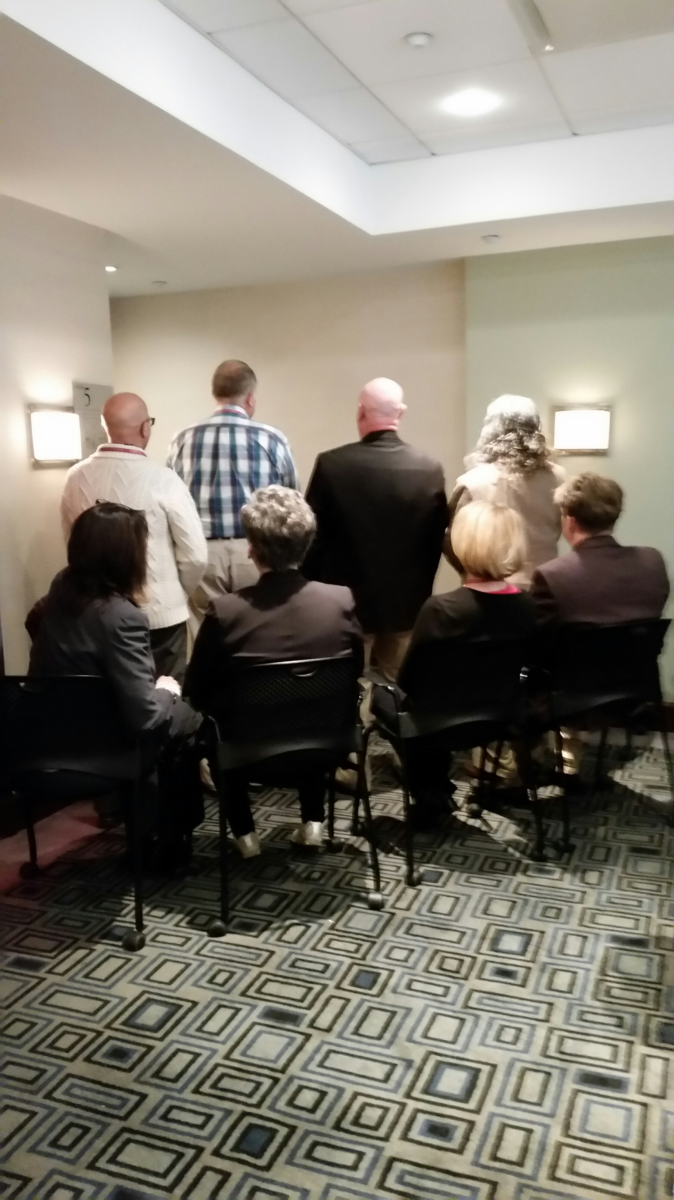


Report and Charter Committee

Slide 64
IX. Report and Charter
A new section on “Local Forums be added to Chapter 9 (the General Service Board) of the A.A. Service Manual, after the “Regional Forums” section with:
Local Forums
In October 2006, the concept of Local Forums was approved by the General Service Board. The purpose of Local Forums is to bring Forum information to A.A. members in remote, sparsely populated areas, urban neighborhoods, or underserved A.A. communities. Any A.A. community or service entity may request a one-and-a-half or two-day Local Forum. Unlike Regional Forums, the responsibility for Forum expenses such as meeting room rental and miscellaneous expenses are assumed by the Local Forum Committee. The General Service Board will send two participants, one from the General Service Office or Grapevine Office, and display literature at Board expense. Like Regional Forums, Board participation in Local Forums requires the approval of the trustee’ Committee on International Conventions/Regional Forums. The Regional Forums coordinator works closely with the Local Forum organizing committee to create an agenda that is responsible to local needs.

Slide 65
IX. Report and Charter
A. The A.A. Service Manual, 2016-2017 Edition:
5. Consider removing endnote #4 in Concept Twelve of the Twelve Concepts for World Service.
Advisory Action:
The following text in endnote 4 be removed from Concept XII on page 73 of the Twelve Concepts for World Service:
4. Bill here, apparently inadvertently, used the phrase “in action and spirit,” instead of “in thought and action,” that appears elsewhere in both the Conference Charter and the statement of Concept XII.

Slide 66
IX. Report and Charter
6. Consider request to revise text in the Concept Eleven essay regarding “male/female” distinctions in the Twelve Concepts for World Service.
Advisory Action:
The following text be removed from the Concept XI Essay on page 58 of Twelve Concepts for World Service:
Women workers present still another problem. Our Headquarters is pretty much a man’s world. Some men are apt to feel, unconsciously, that they are women’s superiors, thus producing a reflex reaction in the gals. Then, too, some of us — of both sexes — have been emotionally damaged in the area of man-woman relations. Our drinking has made us wrongly dependent on our marriage partners.

Slide 67
IX. Report and Charter
We have turned them into our “moms” and “pops,” and then we have deeply resented that situation. Perhaps maladjustment has taken still other turns which leave us with a hangover of hostility that we are apt to project into any man-woman relatedness that we undertake.
It is possible for these forces to defeat the good working partnerships we would like to have. But if we are fully aware of these tendencies they can be the more easily overcome, and forgiven. We can be aware also that any sound working relation between adult men and women must be in the character of a partnership, a non-competitive one in which each partner complements the other. It is not a question of superiority or inferiority at all. Men, for example, because they are men, are apt to be better at business. But suppose we replaced our six women staff members with six men? In these positions could the men possibly relate themselves so uniquely and so effectively to our Fellowship as the women? Of course not. The women can handle this assignment far better, just because they are women. 10
Endnote 10, on page 59 in Twelve Concepts for World Service in the Concept XI essay be revised by the Publishing Department with language noting that two paragraphs have been removed from the Concept XI essay and are available upon request from the G.S.O. Archives Department as a reference to A.A. history.

Slide 68
IX. Report and Charter
B. Consider A.A.W.S. recommendation regarding an alternative publishing schedule for The A.A. Service Manual/Twelve Concepts for World Service.

Slide 69
IX. Report and Charter
Advisory Action:
The A.A. Service Manual be revised per existing schedule after the 2016 General Service Conference and that a new edition be published biannually (i.e., every two years), beginning in 2017 at a savings of approximately $45,000 - 50,000 in alternate years when a new edition is not published. The next edition of The A.A. Service Manual is to be published in 2018 (after the Conference), the subsequent edition in 2020 (after the Conference), etc.

Slide 70
IX. Report and Charter
The category title “Online Meetings be changed to “Online Meetings/Online Groups” on page vi and vii in the A.A. Directories.

Slide 71
X. Treatment/Accessibilities
That the term “Special Needs” be removed from the name of the Conference Committee on Treatment/Special Needs-Accessibilities and throughout the committee’s Composition, Scope and Procedure. The new name of the committee will be the Conference Committee on Treatment and Accessibilities.

Slide 72
XI Trustees
The recommended slate of Trustees be elected to annual meeting of the members of the general Service Board.
The recommended appointment of the slate of officers of the General Service Board be approved.
The February 2016 appointment of officers by the Chair of the General Service Board be approved.
This appointment process is in accordance with the General Service Bylaws.

Slide 73
XI Trustees
The Slate of Directors of the A.A. World Services
The Slate of Directors of the A.A. Grapevine Corporate Board
If a vacancy for a regional trustee occurs prior to September 1 in the first year, then an election for a three-year term would occur at the following General Service Conference (GSC) for the affected region. If a vacancy for a regional trustee occurs between September 1 in the first year and August 31 of the third year then the Delegates from the affected region would be given an option to hold an election for a six-year or five-year term, or leave the position vacant, depending on when the vacancy occurs. Regardless of whether the term was for three, five or six years, the regional trustee would be expected to serve two years on one of the two operating corporation boards.

Slide 74
XI Trustees
Committee Considerations:
The committee reviewed the resumes and approved as eligible for election, all Class B trustee candidates for the west Central and western Canada Regions.
The committee reviewed the report from the Trustees’ Committee on Nominating on expanding the pool of candidates to serve the General Service Board and the Corporate Boards. The committee discussed the suggestions provided by the trustees’ Committee on Nominating for distribution of postings and notifications of vacancies on the Boards and encouraged using as many outlets as possible to develop a broader list of candidates. The committee agreed that a larger pool would provide a wider range of abilities, skills, background and life experiences. The committee also noted that expanding the number of candidates increases the possibility that the candidates will reflect the inclusiveness and diversity of A.A. itself.
The committee also encouraged consultation between the trustees’ Committee on Nominating and the General Service Board to identify the skills and background most needed for each opening on the G.S.B.
The committee discussed the possibility of adding direct questions to the candidate’s resume from that would identify diverse characteristics of candidates and agreed that this was not necessary. Nevertheless, the committee suggested that the trustees’ Committee on Nominating explore the option of adding space to the current resume form that would allow a candidate the opportunity to provide additional information that may identify diverse characteristics, such as abilities, skills, background, and the experiences that may benefit the General Service Board.

Slide 75
XII. Archives
No recommendations.

Slide 76
XIII. International Conventions/ Regional Forums
No recommendations

Slide 77
A Fellowship in Motion….
Committee Chairs should re-convene and discuss 2016 Additional Committee Considerations to determine if there are Agenda Items to be submitted to the Area for consideration in 2017.
Committee Chairs should review Additional Considerations for action items.
DCMs/Districts consider using Conference Theme, presentation, and workshop topics from 2016 GSC for sharing in your districts.
Consider workshops or sharing sessions on “Self-Support” to raise awareness of the concerns moving forward…

Slide 78
Workshops
On Wednesday morning, Conference members split up into
small groups for a workshop session to discuss the trustees'
Feasibility Study Subcommittee report. Each group
was provided with some brainstorming questions and four
separate topics were covered: Communications; Revenue;
Expenses; and Structure. Each group had a moderator
and a reporter and provided a summary from each section
that was presented to the full Conference at a session on
Thursday morning. I had the privilege to serve as a Moderator for the Structure Group. All reports will be detailed in full in the Final Report distributed in September.

Slide 79
Floor Actions
It was recommended that:
1) General Service Conference Delegates be provided a copy of the final approved annual General Service Office and A.A. Grapevine budgets with the pre Conference material for all future Conferences.
2) The General Service Board develop a new policy and a plan that enhances the General Service Conference Agenda Review and Selection Process, providing the Area Delegate members of the Conference a role in the vetting and selection of proposed agenda items through the Conference process to be brought to the 2017 General Service Conference.
3) The trustees’ Committee on the General Service conference create a plan to translate Conference background material, considering all possible methods, with a progress report to be forwarded to the 2017 Conference Committee on Policy/Admissions that describes the process and costs.

Slide 80



Slide 81

My Sincere Appreciation. I am forever grateful to all of you for giving me the honor and privilege to serve the Best Area in the World!!

Slide 82
Presentation
Will be made available on Area59aa.org website along with Financials and Reports
Final Conference Report will be distributed in September and November.

Slide 83
Hope
The beauty of AA lies in knowing that my life, with God’s help, will improve.
The AA journey becomes richer, the understanding becomes truth, the dreams become realities—and today becomes forever.
Daily Reflections p 167
Hope sees the invisible, feels the intangible, and achieves the impossible.
God Bless Area 59 and All of You!
Thank you for being here today!

Slide 84

    QUESTIONS ???
    SCHEDULE DISTRICT DELEGATE VISITS???

