Slide 1

Delegate's Report
69th Annual General Service Conference
Ken D., Delegate
Area 59, Panel 69
Eastern PA General Service
Notes:
Ken Dennison, Member, Midday Miracles, Kennett Square
Current service commitment is delegate
Thank you for participating today and to District 59 for their hospitality

Slide 2
Delegate’s Conference Report
Objective for today:
  Report significant results of the 69th Conference
  Report my role in service to the Conference
Overview – by GSC Committee
  Recommendations (noting Area 59 PCSS Items)
  Participation
  Conference outcome
Notes:
the Conference was held at the Crown Plaza Hotel at Times Square in NYC

Slide 3
www.area59aa.org
Reports and anonymity-protected slides
will be posted after the
June 30th Mini-Assembly

Slide 4
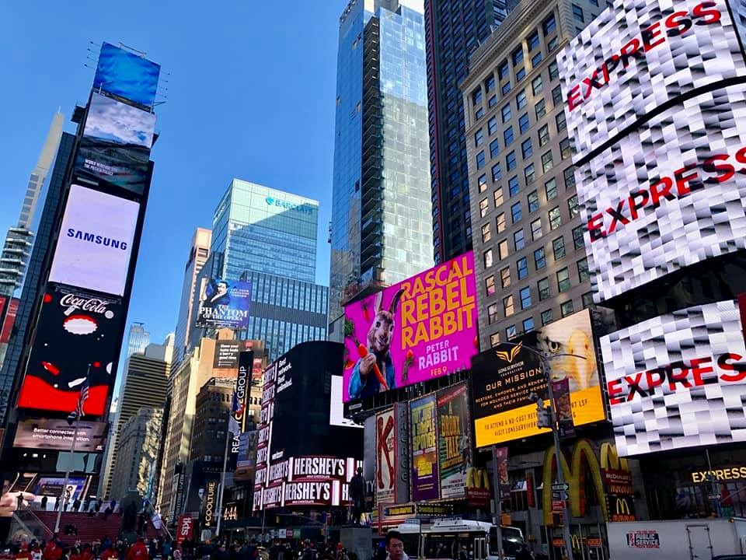
May 19–25, 2019
69th Annual General Service Conference
Crowne Plaza Hotel
Times Square
New York, NY
Notes:
The 69th GSC theme is "Our Big Book - 80 years, 71 Languages"
More to come

Slide 5
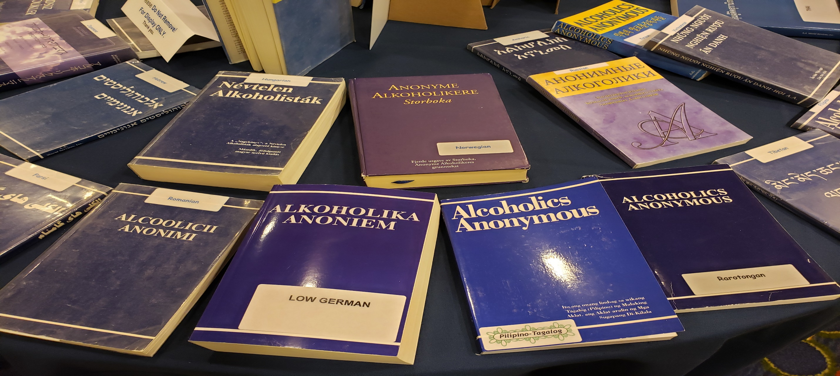
Our Big Book –
80 Years,
71 Languages

Slide 6
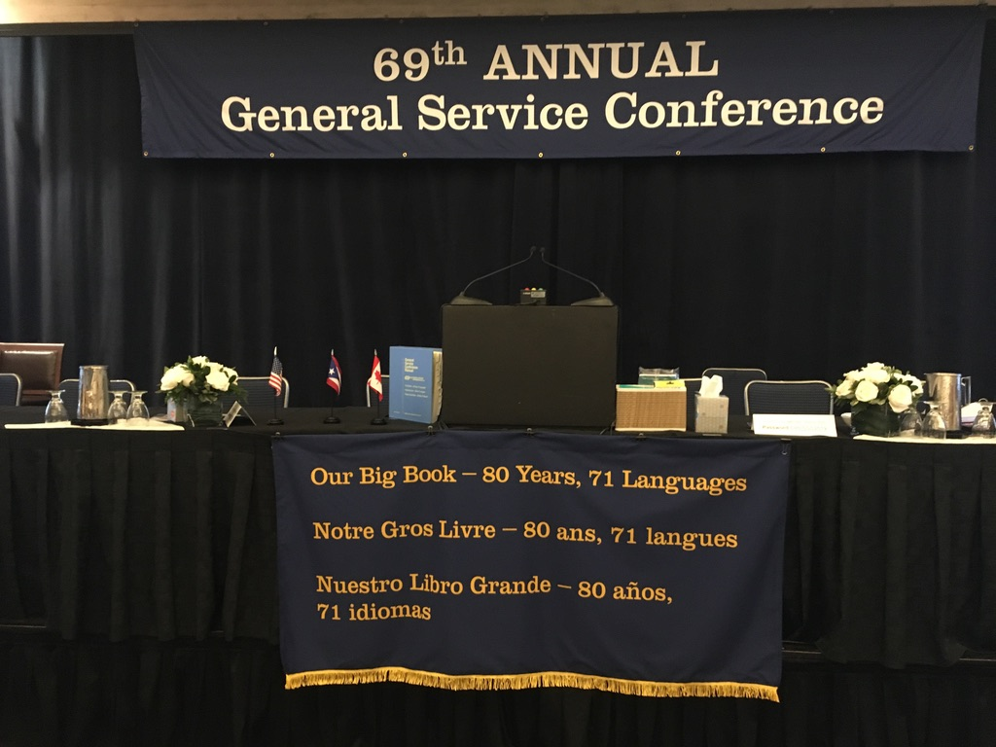

Slide 7
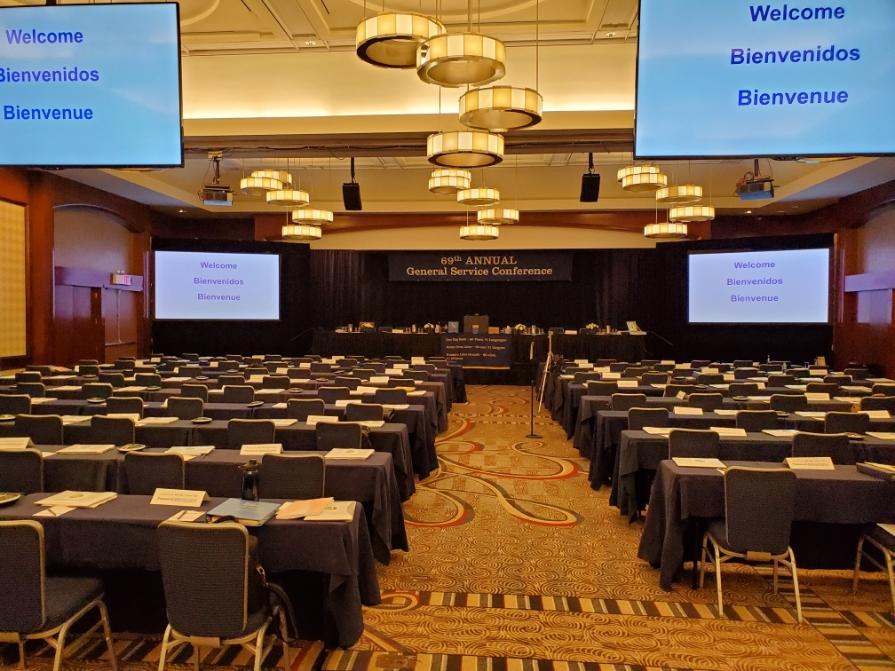

Slide 8
See, Hear & Feel
Saw? Lots of people
  From “bartenders” to ”judges”
Heard? Oh my! Bunches & bunches & bunches!
  Inclusion rather than exclusion
  A strong, loving & informed Group Conscience
Felt? Trust: evolving & growing
  Gratitude for Eastern Pennsylvania – YOU!
  Humility for our message - 80 Years & 71 Languages
  Love for the Fellowship of Alcoholics Anonymous

Slide 9

Who Makes Up The Conference?
135 Total
93 Delegates
USA & Canada
27 Trustees,
AAWS & GV
Directors
69%
20%
15
GSO & GV
Staff
11%

Slide 10
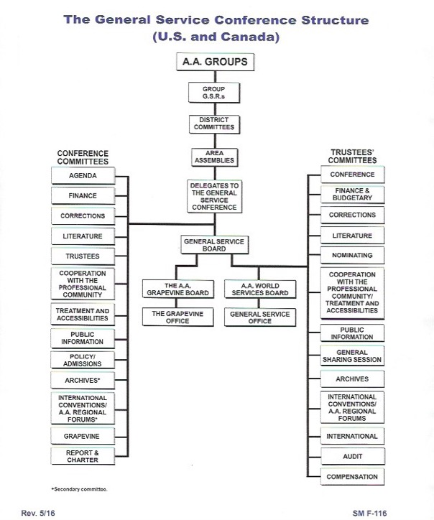

Slide 12
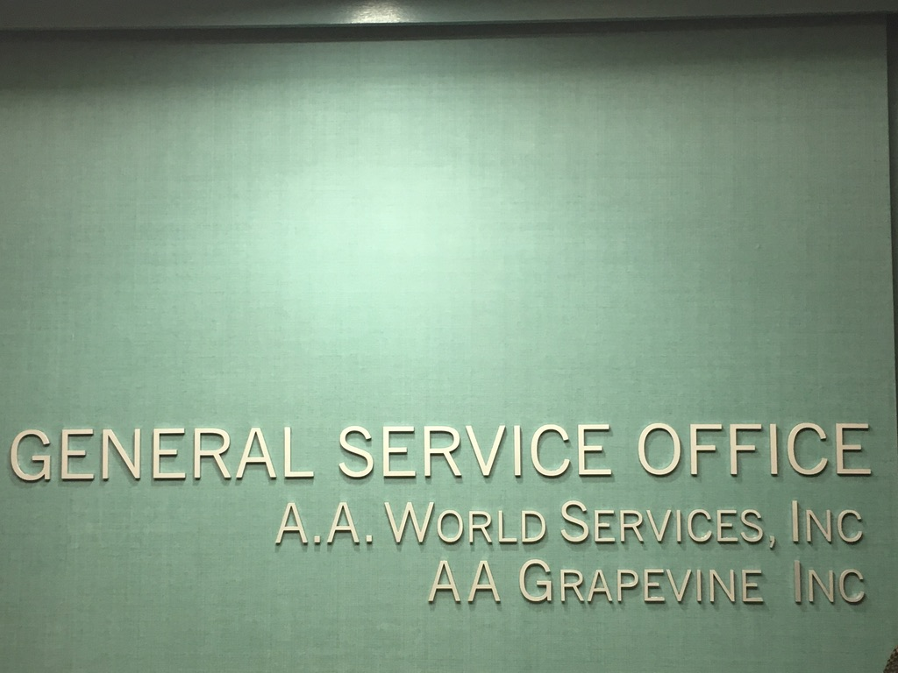

Slide 13
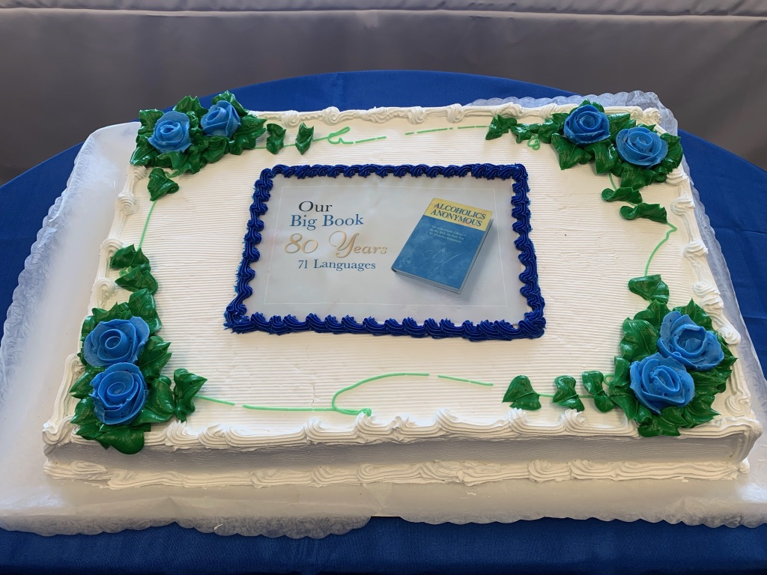
Our Big Book – 80 Years, 71 Languages

Slide 14
AAWS Board Report Summary
May 20, 2019

Slide 15
2018 AAWS Expenses
New positions
Enterprise Resource Planning (ERP) project
Communications audit project
Legal review of all contracts
$135K settlement for the Printer’s Manuscript case

Slide 16
Volume of AAWS Employee Work
91 employees
New website project
AA app project
ERP project

Slide 17
Volume of AAWS Employee Work
1,641 new groups listed
Website received 15 million+ hits
  Responded to 431 emails regarding the website
Answered almost 100K emails and phone calls
Coordinated more than 30 national CPC conferences
Answered 1,600 requests for information from Archives
Welcomed over 3,000 visitors to the office

Slide 18
AAWS Publishing Activity
Completion of the Navajo translation of Alcoholics Anonymous
21 translations of our Big Book in process
265 licenses completed in 2018 compared to 73 in 2017
Our Great Responsibility: A Selection of Bill W.’s General Service Conference Talks

Slide 19

NAVAJO
BIG BOOK
CD SET:
NAVAJO IS A SPOKEN LANGUAGE
Notes:
CUE: p. 3, last paragraph: Another important moment occurred shortly…

Slide 20

“OUR GREAT RESPONSIBILITY”
Notes:
Add picture of cover of new book, please.
CUE p. 5, Paragraph in middle of page: Adding to the celebration of our Big Book, we an also add…

Slide 21

2020 INTERNATIONAL CONVENTION
Notes:
Add logo, please, for the International and add copyright.
CUE: p. 4, bottom sentence: As we move closer to the next International…

Slide 22
Committee System - Corrections
Enables more detailed work
Spreads the work across all participants
Area 59 Delegate assigned to Corrections

Slide 23
Agenda Items: In Committees
Recommendation:
  A motion from a committee to the entire Conference assembly
  If passed, it can result in an “Advisory Action”
Take No Action
  The committee debated the item, but there were not enough votes for substantial unanimity, needed to make a recommendation
Additional Consideration
  The committee discussed the item; there was no final recommendation reached, but the committee offered some important additional questions or suggestions to consider

Slide 24

What is an "Advisory Action?"
Advisory Actions are the result of an affirmative vote by the GSC to move forward with a committee recommendation or other motion
A “Spiritual Handshake” - between the GSC & Board of Trustees
Expresses, with substantial unanimity, the informed conscience of A.A. as a whole
Advises the Board to take action based on the GSC’s Group Conscience

Slide 25
Agenda
A. 70th GSC Theme: “2020: A Clear Vision For You”
B. 70th GSC Presentation Topics:
Recovery – Who Is Missing In Our Rooms?
Unity – Practicing Our Principles
Service – Keeping A.A. Relevant
C. 70th GSC Workshop:
Attraction Through Action
Notes:
Area 59 recommended “Unity In A Divided World”
A star on the slide denotes that Area 59 discussed this agenda item at Pre-Conference Sharing Session.

Slide 26
CPC: Cooperation w Professionals
Rec. (Passed) that the text “They may help arrange hospitalization” be removed from the section “What can you expect from A.A.?” in the pamphlet “Alcoholics Anonymous in Your Community.”
  A59 - passed
A59 – took no action on Linkedin; GSC additional consideration

Slide 27
Corrections
Rec. (Failed) that the scope of the Corrections committee which reads: “The purpose of the committee will be to encourage A.A. members to assume responsibility to carry the message to alcoholics who cannot, of their own free will, seek A.A. help.”
Be revised to:
“…carry the message to alcoholics who cannot seek A.A. help outside the walls.”

Slide 28
Corrections
Review of Corrections literature to make language “more modern and inclusive.” e.g. some areas do not like the term “inmate.”
  No Action because we had no suitable replacements and there was not a widely expressed need to warrant changes.
Review request to establish a database by GSO
No Action because many areas already have built a system and it does not seem appropriate for GSO to build one in this busy year of implementation for ERP.
Notes:
Area 59 took no action on language
Area 59 – additional consideration on the database. Corrections GSC called for a survey by GSO of area practices
Area 59 – suggested God Word pamphlet to Corrections committee. No action. Question on floor became floor action & failed

Slide 29
Public Information
Rec. (Passed) that the trustees’ committee on PI develop a plan to produce videos shorts based on current A.A. pamphlets that provide information about A.A. to the public & a report be brought to the 2020 PI Committee.
Rec. (Passed) that the video PSA “My World” be discontinued. (A59 passed)
Rec. (Passed) that the “Policy on Actors Portraying A.A. Members or Potential A.A. Members in Videos” be reaffirmed. (A59 passed)
  {current policy} “that full-face actors (not A.A. members) may be shown provided that the character being portrayed is not ‘a potential A.A. Member’ or ‘A.A. member.’”

Slide 30
Public Information
Rec. (Passed) that two PSAs be developed at a cost not to exceeds $50,000 for each PSA and that if full-face characters are shown, to include an “actor portrayal” disclaimer on screen.

Slide 31
Public Information
Rec. (Passed) that text addressing anonymity & safety be included in the pamphlet “Understanding Anonymity” as follows: (Area 59 passed)
Q. Is it okay to tell someone if I witness or experience inappropriate behavior that happens either during or outside meeting times? Can I alert the proper authorities if there is criminal behavior?
A. Groups strive to provide as safe an environment as possible in which members can focus on sobriety, and, while anonymity is central to that purpose, it is not intended to be a cloak protecting inappropriate or criminal behavior or calling the proper authorities does not go against any A.A. Traditions and is meant to preserve the safety of all members.

Slide 32
Public Information
Rec. (Passed) that the wording of the last sentence in the section titled “How A.A. Members Maintain Sobriety” in the flyer “A.A. at a Glance” be changed from:
“Sobriety is maintained through sharing experience, strength and hope at group meetings and through the suggested Twelve Steps for recovery from alcoholism.”
To:
“Sobriety is maintained through sharing experience, strength and hope at group meetings and through the suggested Twelve Steps of Alcoholics Anonymous which are suggested as a program of recovery.”

Slide 33
Public Information
Rec. (Passed) that a progress report on the usefulness & effectiveness of YouTube channel be brought to 2020 GSC on PI.
Rec. (Passed) that all current PSA titles be updated for search optimization purposes.

Slide 34
Public Information
Rec. (Passed) that AAWS & AA Grapevine apply for “LegitScript” certification to qualify for Google Ad Words/Grants.
Rec. (Passed) that AAWS apply for Google AdWords Grants, for the purpose of providing information about A.A. to the public.
Rec. (Passed) that AAWS implement Google AdWords for the purpose of providing information about A.A. to the public & that a report be made to the 2020 GSC on PI.

Slide 35
Finance
Rec. (Passed) that the level for individual bequests to the GSB from A.A. Members be raised to $10,000.
  7 bequests per year at $5k.
No Action on delegate fees.
  < 10 areas contribute full amount
No Action on $5,000 maximum Member contribution
  Area 59 – No action

Slide 36
Treatment & Accessibilities
Rec. (Passed) that Ashley’s story (an A.A. Member who is deaf) be added to the pamphlet “Access to A.A.: Members Share on Overcoming Barriers” and that the video version of the pamphlet be updated to reflect this change. (A59 passed)
Rec. (Passed) that the pamphlet “A.A. for the Older Alcoholic – Never Too Late” be updated with a revised introduction; current and inclusive stories; reference to online A.A.; and an updated “How Do I Find A.A.?” section. (A59 passed)
Rec. (Passed) that trustees’ CPC & Treatment committees develop anonymity-protected audio interviews w military professionals about their experience with AA as a resource

Slide 37
Treatment & Accessibilities
Consider revising the pamphlet “Bridging the Gap” to include related corrections activities.
  Area 59 – passed
  Conference – additional consideration: research further & bring report to 2020 Conference

Slide 38
Grapevine
No Action on a request to remove the “Alcoholism At Large” section from the AA Grapevine.
  (A59 – No action)
Suggested some working titles for new AA Grapevine books to produce in 2020:
  The Early Days
  Getting Involved in General Service
  Surrender and Hope (LaVina book)

Slide 39
Grapevine
No Action: AAGV Fellowship Feedback survey & summary
  Area 59 – No action
No Action: Review progress report on the development of the pamphlet on A.A.’s Three Legacies.
  Area 59 – No action

Slide 40
Literature
Rec. (Failed 54-78) that a draft 5th Edition of the Big Book be developed. First 164 pages, appendices & Dr. Bob’s story remain as is.
  Area 59 – supported
  Delegate voted against the recommendation after hearing about the workload at A.A.W.S.
  Motion to Reconsider: (Failed)
Notes:
AAWS staff
Need to update digital content and graphics, audio and videos
& Directors against due to timing
and recent focus to update pamphlets and PSA
This does not mean it will not happen…

Slide 41
Literature
Rec. (Passed) that the pamphlet “Q & A on Sponsorship” be revised to add the following text regarding anonymity: 1. Under section, “What does a sponsor do and not do?” (p13), after the current bullet “Impresses upon the newcomer the importance of all our Traditions,” add a new bullet with the following language:
Emphasizes the relevance and spiritual value of anonymity, both on a person to person basis, as well as at the public including social media. (For more information see the pamphlet “Understanding Anonymity”).
2. Under the section, “How can a sponsor explain the AA program?” (p.15) add a 6th paragraph:
Many sponsors discuss the significance of anonymity as a personal and public level early on. Anonymity at a personal level provides protection for all members from the identification as alcoholics, a safeguard often of special importance to newcomers.
At the public level of press, radio, films, and other media technologies, such as the internet, anonymity stresses the equality in the Fellowship of all members by putting the brake on those who might otherwise exploit their AA affiliation to achieve recognition, power, or personal gain. The sponsor is quick to point out the benefit of anonymity at this public level. Sponsors may provide examples from their own experience of maintaining public anonymity.
Notes:
Area 59 passed

Slide 42
Literature
Create a Literature Committee Workbook
  Conference – Additional Consideration for 2020
  Area 59 supported this agenda item
Revise pamphlet “Too Young”
  Area 59 – No action; GSC – additional consideration
Review “Young People In A.A.”
  Area 59 – No action; GSC – additional consideration

Slide 43
Literature
Revise the pamphlet “The AA Group”
  Area 59 – No action
  GSC – No action

Slide 44
Literature
Rec. (Failed) that a paragraph about the 12 Concepts be added to the Forward of the Twelve Steps and Twelve Traditions. (Area 59 – No action)
Rec. (Failed) a change about non-alcoholics attending Open Meetings on the Blue Card. Area 59 – No action)
Notes:
Not considered at Area 59 PCSS but received much discussion for & against at Conference

Slide 45
Trustee Elections
Francis G. (Area 30), Northeast Regional
Trish L., Canada At-Large Trustee
James D., Southwest Regional
All elections were finalized by drawing “from the hat”

Slide 46
Trustees
Recommended Slates:
  General Service Board – Passed
  GSB Officers - Passed
    (Michele Grinberg, J.D., Chairperson)
  A.A.W.S., Inc. Board – Passed
  AA Grapevine, Inc. - Passed

Slide 47
Policy/Admissions
Rec. (Passed) a change in the “Process for Polling The GSC between Annual Meetings”
New policy:
“Voting will commence on day seven at 2 p.m. after discussion closes.”
“Voting will close at 2 p.m. two weeks after the poll was emailed…”

Slide 48
Policy/Admissions
Consider 1986 Advisory Action regarding a majority vote by GSC being a “strong consideration.”
  GSC Committee – took no action
  Advised GSO to follow advisory action in place by “duly recording simple majority votes”
  Much discussion
Area 59 “string suggestion should be recorded.”

Slide 49
International Conventions/Regional Forums
Rec. (Passes) that an anonymity-protected photograph of the flag ceremony at 2020 International Convention (IC).
Rec. (Passes) that anonymity-protected internet broadcast of the 2020 IC opening flag ceremony be approved.
Rec. (Passes) that an anonymity-protected video with highlights of the 2020 IC be produced for maintaining archival footage and possible sharing the spirit and enthusiasm of the IC.

Slide 50
Archives
Rec. (Passes) that the 1940’s home movie of the co-founders and their wives be added to the Archives video “Markings on the Journey” at an est. cost of $5,000.
  Area 59 supported

Slide 51
Floor Actions
1. Draft 4th Edition Spanish Big Book to be brought to the 2020 GSC. (Motion to commit to trustees’ literature committee passed.)
2. Production of the AA Grapevine book, Language of the Heart in Spanish as an audio book with a timeline be reported at 2020 GSC. (Failed)
3. Rec. “The God Word” pamphlet be added to the Corrections Kit. (Motion to Decline to Discuss Passes)
4. that the pamphlet “AA For the Black and African-American Alcoholic” be updated and report to 2020 GSC. (Recommitted to Trustees Literature)

Slide 52
Floor Actions
5. In order to illustrate the importance of the committee recommendations that achieve simple majority but not substantial unanimity (i.e., a vote of two-thirds), that such “simple majority suggestions” be prominently included in the GSC Final Report. (Failed)
6. That the “Alcoholism At Large” section of the AA Grapevine be removed. (Declined to consider)
7. The AAWS Policy on Publications of Literature: Updating Pamphlets and Other AA Materials” be recommitted to trustees’ Literature committee with an updated policy reported to the 2020 GSC. (Passes)
Notes:
Area 59 Literature recommended the adoption of the new editing policy
It failed on the flo0r at PCSS
GSC Literature was going to take no action; but a floor action was presented and accepted
The floor action passed for commit to Trustees Literature – so it lives on…

Slide 53

AROUND THE PICNIC TABLE
Finance
2019
GSC
David M. Morris, C.P.A.
Class A (nonalcoholic) Trustee
General Service Board Treasurer
Notes:
Slide 0 – Good afternoon. My name is David Morris and I am a Class A trustee and treasurer of the General Service Board. It is again my privilege to deliver this year’s Treasurer's report to the 69th General Service Conference of Alcoholics Anonymous or, as it is more commonly referred to, “Finance around the Picnic Table,” the phrase coined at the 59th Conference. This phrase means that much of the finance discussion during Conference is "preaching to the choir." As always, what we need is better communications about what finance really means when members talk about the “numbers” around the euphemistic picnic table before and after meetings. Clear communication is the key. Although our finances continue to grow ever more complex, remember that Corporate Poverty is more a state of mind, rather than the size of our bank account. “Too much – and we argue over perilous wealth and lose sight of our primary purpose of carrying the message. Too little – and we risk losing the ability to carry the message at all.”

Slide 54
2018 FINANCIAL HIGHLIGHTS
7th Tradition of Self-Support – $8.4 million, almost equal to 2017 record
Cost of Services Provided to Fellowship – $11.4 million, up 11.8% from 2017
Shortfall between 7th Tradition of Self-Support and Cost of Services Provided to the Fellowship – $3.0 million
AAWS publishing profits – $3.4 million, down 4%, used to cover shortfall between 7th Tradition and Cost of Services, resulting in net GSO profit – $0.4 million
Grapevine subscription levels declined in 2018. GV would have essentially broken even, if not for severance payments
General Fund support of La Viña service activity – $148 thousand
Reserve Fund – $15.9 million, resulting in ratio of 9.7 months
Notes:
Slide 1 – lists the key financial highlights from our 2018 operating results:
7th Tradition of self-support contributions were $8,385,009, down 0.3% from 2017
Cost of services provided to the Fellowship were $11,426,835, up $1,204,185, or 11.8%, from 2017
Shortfall between our 7th Tradition and cost of services provided was $3,041,826, or 73.4%, compared to $1,813,178, or 82.3%, in 2017
AAWS publishing profit of $3,436,507 covered shortfall between our 7th Tradition and cost of services, resulting in a profit of $394,681
Grapevine subscription levels declined in 2018. GV had a loss of $149,167, primarily due to severance payments.
General Fund support of La Viña service activity was $148,467, compared to $126,440 in 2017
Reserve Fund was $15,935,331, resulting in a ratio of 9.7 months, compared to 9.5 months in 2017.

Slide 55

A DOLLAR IS NOT WHAT IT USED TO BE
Remember inflation when deciding upon your
7th Tradition
Self-Support
Contributions for:
Group Meetings
Online Recurring Contributions
Birthday Gifts
November Gratitude Month
1935: $1.00
2018: $18.55
Notes:
Slide 20 – illustrates the pervasive and very negative effects of how inflation has diminished the value or purchasing power of one dollar since the very first days of A.A. through today. It shows that $1.00 in June 1935 is now equivalent to $18.55 in 2019, regardless of what that 1935 dollar was spent on, whether it went for alcohol, coffee or put into the 7th Tradition Self-Support basket.
Source – 2019 inflation information is from U.S. Department of Labor, Bureau of Labor Statistics, CPI Inflation Calculator website.

Slide 56
MEMBER SERVICES & STATISTICS – 3 YEAR HISTORY
 | 2018 | 2017 | 2016
Number of Members | 1,418,177 | 1,381,954 | 1,362,402
Cost of Services per Member | $8.06 | $7.40 | $7.27
7th Tradition Self-Support Contributions per Member | 5.91 | 6.09 | 5.82
Cost of Services NOT covered by Self-Support | 2.15 | 1.31 | 1.45
Number of Groups | 68,478 | 66,860 | 66,336
Cost of Services per Group | $166.87 | $152.90 | $149.34
7th Tradition Self-Support Contributions per Group | 122.45 | 125.78 | 119.62
Cost of Services NOT covered by Self-Support | 44.42 | 27.12 | 29.72
Percentage of Groups Contributing | 41.3% | 43.7% | 41.5%
Number of Groups that Contributed | 28,314 | 29,219 | 27,542
7th Tradition Self-Support of Groups that contributed – Slide 8 | $237.35 | $231.34 | $234.41
37
Notes:
Slide 37 – displays key member statistics for 2018 and the prior two years. These member statistics are simple calculations using the 7th Tradition contributions and the cost of services provided to the Fellowship divided by the number of members and groups shown on the Contribution Statistical Report. Remember that those membership numbers are only as good as the data we capture in an anonymous fellowship system. The 2018 cost of services provided of $11,426,835 equates to $8.06 per member and $166.87 per group. The 2018 contributions of $8,385,009 equates to $5.91 per member and $122.45 per group. The cost of services provided are NOT covered through 7th Tradition is $2.15 per member and $44.42 per group. Only 28,353 groups, or 41.3%, actually contributed towards the 7th Tradition. This equates to an average amount of $237.35 per group.

Slide 57
This year’s $8.06 on August 6th Seventh Tradition Member Challenge
$8.06 per member per year
Notes:
Read slide

Slide 58
August 6, 2019
$8.06 per member contributed to GSO
would make GSO fully self-supporting
So…
On Tuesday, August 6th
go to www.aa.org
And please contribute $8.06 to A.A.

Slide 59
SERVICES SUPPORTED BY 7th TRADITION
PERCENTAGE – 2004 – 2018
36
Notes:
Slide 36 – shows the percentage of the cost of services provided to the Fellowship that were covered through the 7th Tradition for the last fifteen years. For 2018, the percentage was 73.4%. See Slide 36 – Support 1 for details.

Slide 60
PERCENTAGE OF GROUPS THAT HAVE CONSISTENTLY CONTRIBUTED DURING THE LAST SIX YEARS
Notes:
Slide 9 – is the first time that we have been able to provide this information. Due to the extraordinary hard work of our finance and contribution teams, we can now break down the 7th Tradition contributions between Groups that have consistently contributed during the last six years and Groups that have made less frequent contributions during the last six years. In 2018, 17,257 groups, or 60.1%, contributed $5,031,270 with each of these groups contributing some amount consistently during the last six years. There were 11,057 groups, or 39.1%, contributed $1,689,017 on a less frequent basis during the six years.

Slide 61








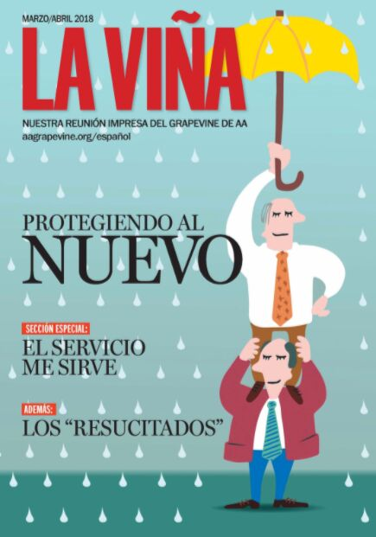




&
Slide from Albin Z., GV Publisher

Slide 62
GRAPEVINE – AVERAGE CIRCULATION – 5 YEAR HISTORY
Notes:
Slide 50 – shows Grapevine’s magazine print, online and mobile app subscriptions for the last five years. The total of all types of subscriptions was 72,300 in 2018, down 3,029, or 4.0%, from 75,329 in 2017. Print subscriptions were down 2,392, or 3.5%, to 66,857 in 2018 from 69,249 in 2017. On-line and APP subscriptions were down 637, 10.5%, to 5,443 in 2018 from 6,080 in 2017. These results reflect the necessary initiatives undertaken by Grapevine during the past several years, such as the automatic check the box for the purchase of a subscription to the Grapevine included in the participate registration form to the 80th International Convention, “2018 Subscription Challenge,” “Carry the Message with the Subscription Gift Certificates,” and “Grow Your Grapevine.” Magazines function on the ongoing need of renewal by existing subscribers and new subscribers in order to succeed.

Slide 63
AAGrapevine & La Vina
2018 Total circulation declined to 66,857 from 69,249
Income $1.3 million – with loss of $149k
  Unusual one-time expenses
GV Book Sales $835k – LOH top seller
La Vina – circulation declined to 9,635 from 9,996
  Cash shortfall = - $148,467
  covered from General Fund (G.S.O.)

Slide 64
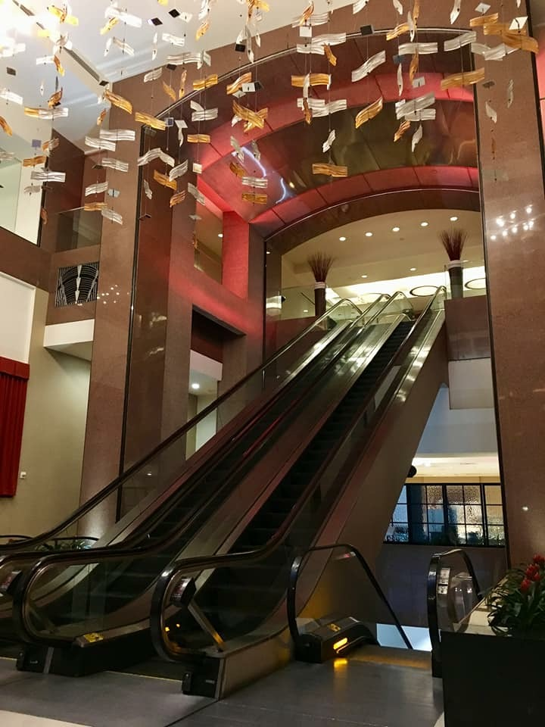
Take the Steps?

Slide 65
I could not conclude anything other…
than that
“A.A. is alive, thriving and growing around the world as we carry the message to the suffering alcoholic!”

Slide 66
Thank you for the opportunity to serve!

Slide 67
2018 AAWS Financial Results
        Actual 2018 Budget 2018 Actual 2017
  Sales $14,020,149 $13,780,000 $13,693,372
  Cost of goods 4,567,534 4,519,755 4,331,759
  Sales gross profit $ 9,452,615 $ 9,260,245 $ 9,361,613
  Contributions 8,384,721 8,200,000 8,409,452
  Total revenue $17,837,336 $17,460,245 $17,771,383
  Total expenses 17,382,733 16,958,552 16,012,547
  Income $ 454,063 $ 501,693 $ 1,758,837
Online contributions = 10.4% of total dollar contributions

