Slide 1




Digital Contributions & the 7th Tradition
Area 59 Finance Subcommittee

Slide 2
Goals of this Presentation
Explain why the 7th Tradition is vital even when most meetings are online.
Share financial best practices and help groups prepare for a transition to online contributions.
Provide key points to consider when evaluating any digital platform.
Show a high-level overview of some current options for digital contributions.
The main goal is to provide information so groups can make an informed decision!

Slide 3

PLEASE REMEMBER
The information in this presentation is offered as shared experience, not as directives or advice. Our Fourth Tradition states that each AA group should be autonomous, except in matters affecting other groups or AA as a whole. How groups choose to handle their finances is ultimately up to the group conscience.

Slide 4
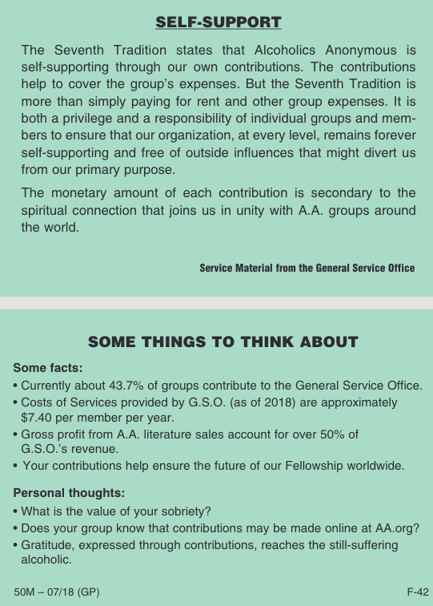


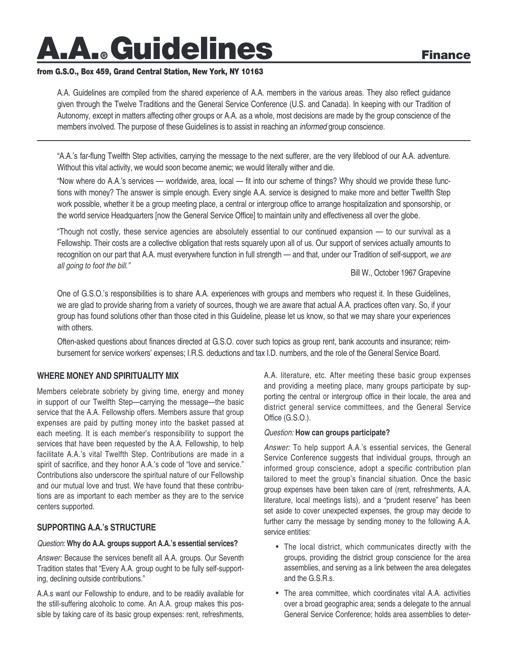
AA Literature
F-3
F-96
MG-15
F-42

Slide 5


Importance of the 7th Tradition
Services Make
AA
Tick

Slide 6
Vital AA Services
Even with most meetings online, services entities beyond the home group are always working to reach the still suffering.
Intergroups, Districts, and Areas are now offering more services online to all members.
Contributions beyond the home group are essential to carry the message!
  Your local Intergroup (if you have one), which provides many services and direct support to groups and alcoholics.
  Your local District, which serves as a link between your home group, the Area, and all of AA. Particularly in places without an Intergroup, its 12th step work is essential.
  Your Area, which coordinates vital activities over a broad geographic area. Area 59 (EPGSA) covers all of Eastern PA.
  AA’s General Service Office, which functions as a storehouse of AA information and communicates with members and groups around the world.

Slide 7
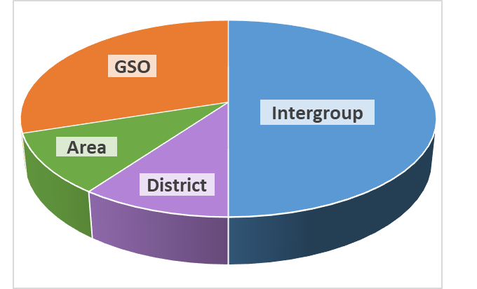
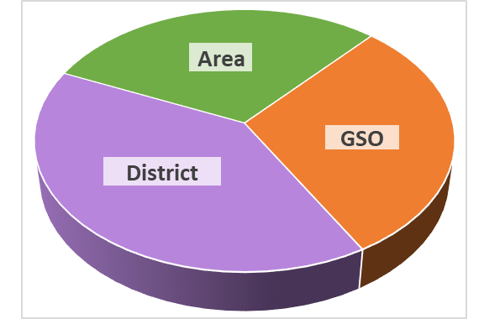
Splits & Contributions
Each AA group determines for itself, through the group conscience, how much to contribute to other service entities.
Pie charts are examples only to show possible ways of splitting contributions.
Groups typically contribute the amount of money in their group account that exceeds their prudent reserve.
Consider setting up a regular contribution schedule, whether quarterly, semi-annually or annually.
Example with Intergroup
Example without Intergroup

Slide 8

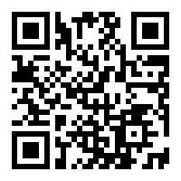

How to Make Contributions
Local District – Contact your GSR
Intergroup (Sepia)
  aasepia.org/donate
  1903 South Broad Street -- 2nd Floor
  Philadelphia, PA 19148-2216 –Checks payable to SEPIA
Area 59
  area59aa.org/contributions
  Area 59 Treasurer
  14 Casey Drive
  Williamsport, PA 17701 – Checks payable to Area 59
General Service Office
  contribution.aa.org
  General Service Office, Box 459
  Grand Central Station
  New York, NY 10163 - Checks payable to General Service Office

Slide 9
Some Group Questions
Since we are not meeting at our usual facility, should we pay rent?
  Ask your landlord.
  You will need a meeting space once restrictions are lifted.
  Do you have supplies stored?
Who should pay for our Zoom account?
  If it’s a group expense, it should be paid for by the group.
  It’s recommended no one person control the account.
  A member who wished to donate the account could simply make a normal contribution.
Should we donate to the church, since they aren’t accepting rent?
  Consult AA literature and the 7th Tradition.
  Ultimately, it’s up to the Group Conscience.

Slide 10

Group Finances
Suggested Best Practices

Slide 11
Best Practices
Utilize a group bank account
  Personal accounts put both the treasure and group at risk.
  Multiple officers should be on all accounts.
Create all online accounts in the group’s name.
  Create a group email address and use it for all accounts.
  Consider getting a free Google Voice number. (Useful for online payments.)
Have annual budget by group conscience
  Maintain a prudent reserve
  Save funds to send GSR to EPGSA
  After group expenses, determine amount to contribute to service entities.
Treasurer should have a reasonable amount of sobriety
  Should be capable of writing checks and managing online payments.

Slide 12
Group Bank Accounts
Account Type:
Business/nonprofit checking no fee account.
  Many banks will waive account fees for community groups.
Have two signatures on account.
  Consider requiring two signatures to write checks.
Set-up procedures vary by bank, but most require:
Employer Identification Number (EIN)
  Banks are now required to obtain an EIN for new accounts.
  An EIN is the IRS Tax ID for entities, whether they have employees or not.
  Go to irs.gov - “Apply for an Employer ID Number.” (form SS-4)
Social Security Number.
Meeting Minutes or Bylaws.
  AA 12 Traditions can often suffice.

Slide 13

Poll on Digital Contributions

Slide 14

With All Digital Platforms...
Key Points to Consider

Slide 15
First Things First
Will this be for online meetings only or a long-term solution for the group?
  Long-term solutions require longer-term planning.
Will the group be using its own bank account?
  If not, contemplate the implications of digital transactions being linked to a personal account.
  Consider extra precautions to protect the group and ensure accountability.
How organized is your treasurer?
  Will the treasurer be able to handle the additional effort of reconciling digital contributions?
Does your group really need online contributions?
  Members can just set aside cash in an “AA piggybank”.

Slide 16
Communication
When during the meeting will you announce the 7th tradition collection?
  Consider keeping contribution information available throughout the meeting.
How will you communicate?
  Chat window?
  Screen share at end of meeting?
  URL, QR Code, etc.
What information will you share?
  Do not forget options for those without online payment ability.
  Remember to post links/information for other service entities, such as Intergroup, District, Area, and GSO!

Slide 17
Anonymity
Almost all digital payment options require sacrificing some anonymity.
  At a minimum the treasurer will know the user’s “name” in the payment app, and likely the email address.
  Apps with “social” feature like Venmo often share transactions with the user’s “friends” by default.
  Be prepared to offer guidance to members on how to protect their anonymity with whatever platform you choose.
Treasurer has greater anonymity concerns:
  Treasurer could break personal and member anonymity, depending on how the option has been set up.
  Does your group need to create a policy around storing the transaction history of those who give contributions?
Members or Treasurer may not be comfortable with online contributions
  Decision is ultimately up to the Group Conscience and personal choice.

Slide 18
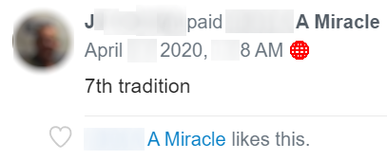
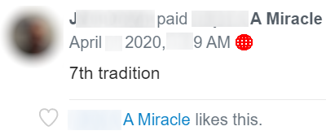
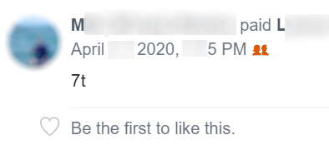
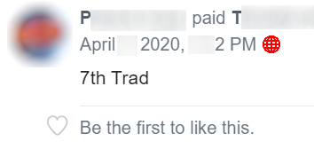
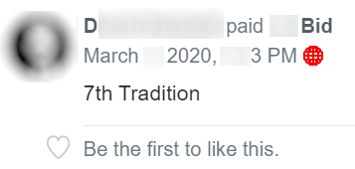
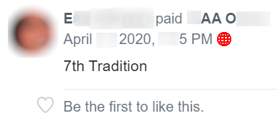
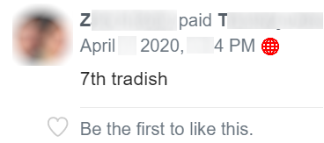
A Cautionary Tale...

Slide 19
You Really Ought To...
A Cautionary Tale...
STOP!

Slide 20
Ease of Setup &
Management
What level of technical expertise is required to setup and manage payments?
  Ensure option chosen does not rely on one member’s knowledge.
  Consider how easy it will be for future treasures.
Are additional accounts required to take different payment types?
  Bank, PayPal, Stripe, email, Google voice, etc.
  How easy will it be to transfer all the accounts when treasurer rotates?
What is the process for managing payments?
  Does money need to be transferred from one account to another?
  How quickly will the group have access to funds?

Slide 21
Member Ease of Use
Payment Methods
  Credit cards, PayPal, Bank, Venmo, etc.
How will members make contributions?
  Website, mobile app, or both?
  What are most members already comfortable with?
  Do not forget the needs of those with limited access to online options!
How easy is the setup for the person making the contribution?
  If online site, is the payment form intuitive?
  Does the user need to install an app?
  How do they link their bank account or credit cards?
  Do they need to create an account for the service?

Slide 22
Fees
Transactions & Account
Is there an account maintenance fee?
  Some platforms are free, some have a fixed fee, some charge per transaction.
What are the transaction fees?
  Standard rate for PayPal and other payment processors such as Stripe:
    2.9% per transaction plus $.30
    Nonprofit rate is 2.2% + $.30
  Some platforms charge an additional transaction fee, usually those that simplify the setup and management.
Is there an option for the user to cover the transaction fees?
Have you done the math?
  $1,000 in contributions would have approximately $35 - $45 in fees.
  Greater impact if many transactions of a small amount.

Slide 23



Final Considerations
Easy Does It
Act “As If”
Think! Think! Think!

Slide 24
Overview of Digital Options
Websites
Mobile Apps
Bank Services

Slide 25
Website Payments
Offer forms where users can enter payment details.
  PayPal.com, Donorbox.org, Givebutter.com
  Many also offer mobile apps.
Typically offer more management of contribution and transaction history.
  Slightly higher cost due to transaction fees, but that is often offset by greater accountability in managing contributions.
  High volume of small contributions will result in more fees.
Usually not too complex to set up but do require some effort.
  May require additional accounts for certain payment types.
Potentially well suited for a longer-term solution:
  Group bank accounts, email accounts etc. are generally easier to use with these platforms vs. mobile only.
  Likely easier to rotate between treasurers.
  .

Slide 26

Mobile Apps
Users make contributions from an app on their phone.
  Venmo, Cash.App, Google Pay, Apply Pay
  Typically simple to use.
More anonymity concerns, depending on the app its setup.
  Venmo requires changing the default settings to protect your anonymity.
  Apps are often linked to user’s mobile phone number, although some allow use of a Google Voice #.
Easy for a group to set up, but there is a price...
  Less accountability and contribution management.
  Treasurer rotation and accountability could be more difficult.
  Potentially less suited for longer-term solution.
  Fully research the details; not all options have the same risk.
Use of group accounts strongly suggested!
  .

Slide 27

Bank Services
Uses a service offered by a member’s own bank.
  Many banks offer free ways to pay others.
  Zelle is one of the most common.
Banks often have free option to send physical checks from their online service.
  If group already has a mailing address, could be a simple option.
Relatively easy to set up and use, but not all banks offer the service.
Not all members may know about these options.
Anonymity and other concerns are roughly equivalent to that of writing a check.
  .

Slide 28

Comparison of Options
Listed are a few of many...
Websites
  PayPal.com
  Donorbox.org
  Givebutter.com
Mobile Apps
  Venmo
  Cash.App
  Google Pay / Apple Pay
Bank / Other Payment Services
  Zelle
  Stripe
4 possible options will be compared
  We are not recommending use or disuse of any option.
  .

Slide 29
PaPal.com
P
Overview
  PayPal is a website/service that enables you to pay, send money, and accept payments.
  .
Anonymity Considerations
  Information is captured based on the user’s PayPal account or name they enter when making a credit card payment.
  Only the treasurer or those with access to the PayPal account will have access.
Payment Types
  PayPal account.
  Debit/Credit
Ease of Use
  Works on a desktop/laptop, or mobile.
  Payment form straightforward
  Basic forms do not offer mobile integration.
  .
Setup
  Recommended to create a business PayPal account to meet terms of service, allow for easier treasurer rotation, and payment tracking.
  Business account is free, and not difficult to set up and link to a bank account.
  Offers basic payment forms with fixed amounts, variable amounts, and recurring contributions.
  Also integrate with web sites for more sophisticated options.
Fees
  2.9% per transaction + $.30, (Non-profit 2.2%)
  .

Slide 30
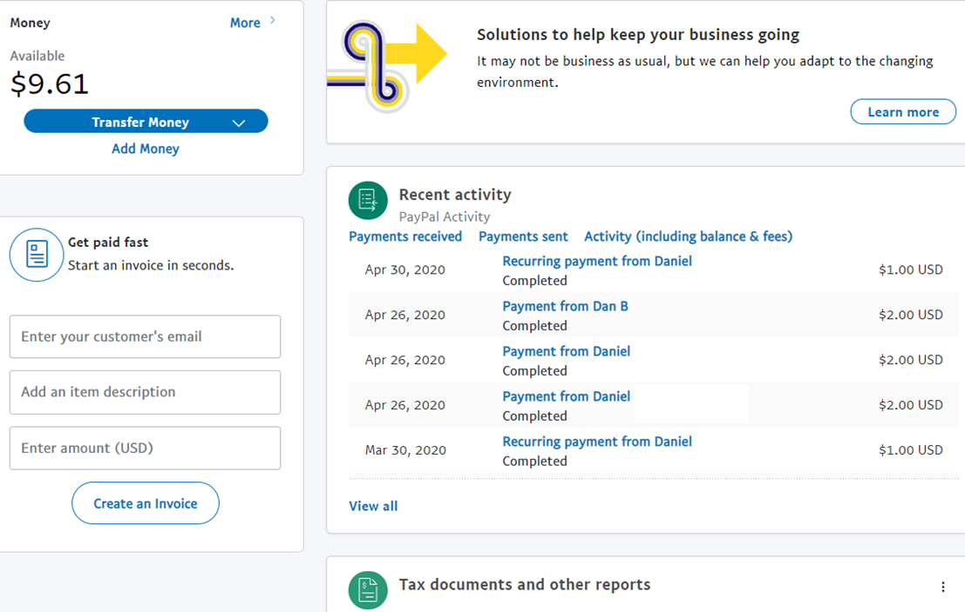
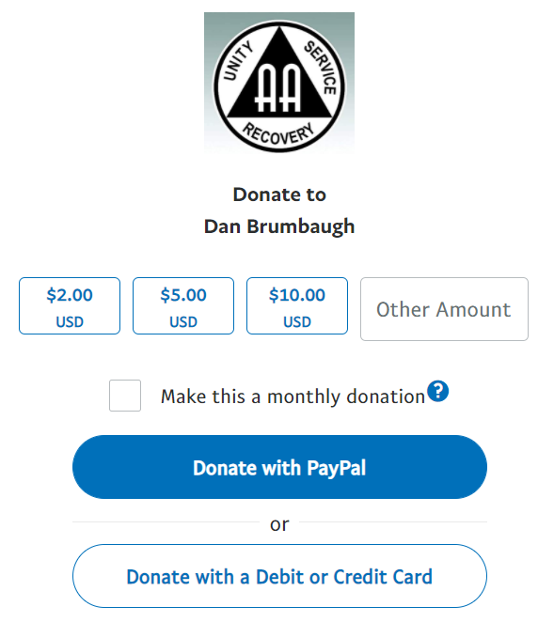
PayPal.com
P
What It Looks Like
Payment Form
Dashboard

Slide 31
PayPal.com
P
Summary
Suitable choice for longer-term online contributions
  Offers basic options for payments forms, probably adequate at the group level.
Setup is not difficult.
Many people are already familiar with PayPal, and payment is simple.
Anonymity concerns are the same as any other business-type platform.
Fees are standard for the industry.
  .

Slide 32
Donorbox.org
D
Overview
  Donorbox is a powerful fundraising platform designed for charitable contributions.
  .
Anonymity Considerations
  Information is captured based on the user’s PayPal account or name they enter when making a credit card payment.
  Only the treasurer or those with access to the Donorbox account will have access.
Payment Types
  PayPal account.
  Debit/Credit
  Google Pay/Apple Pay on mobile.
Ease of Use
  Works on a desktop/laptop, or mobile.
  Payment form intuitive.
  Integrated mobile payments.
  .
Setup
  Requires a separate PayPal account for PayPal, Stripe account to take Credit/Debit cards.
  Stripe account is not difficult to setup.
  Total of 3 accounts to manage including Donorbox.
  Simple to create attractive payment forms with many customizable options.
Fees
  2.9% per transaction + $.30, (Non-profit 2.2%)
  If over $1,000 contributions per month, additional 1.5% fee per transaction.
  Offers e-check option with .8% transaction fee.
  Stripe and PayPal process your payments directly.
  .

Slide 33
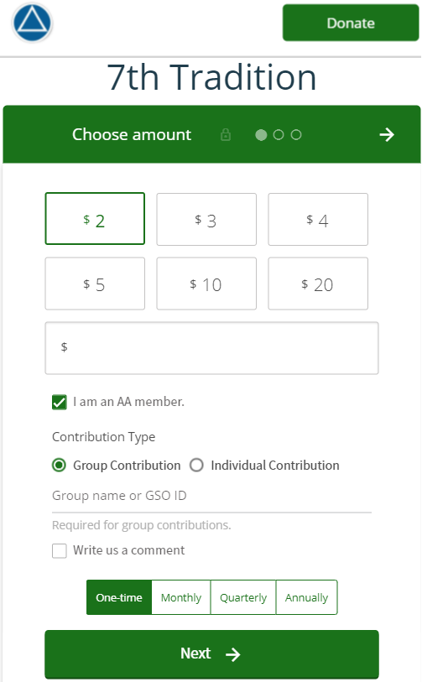
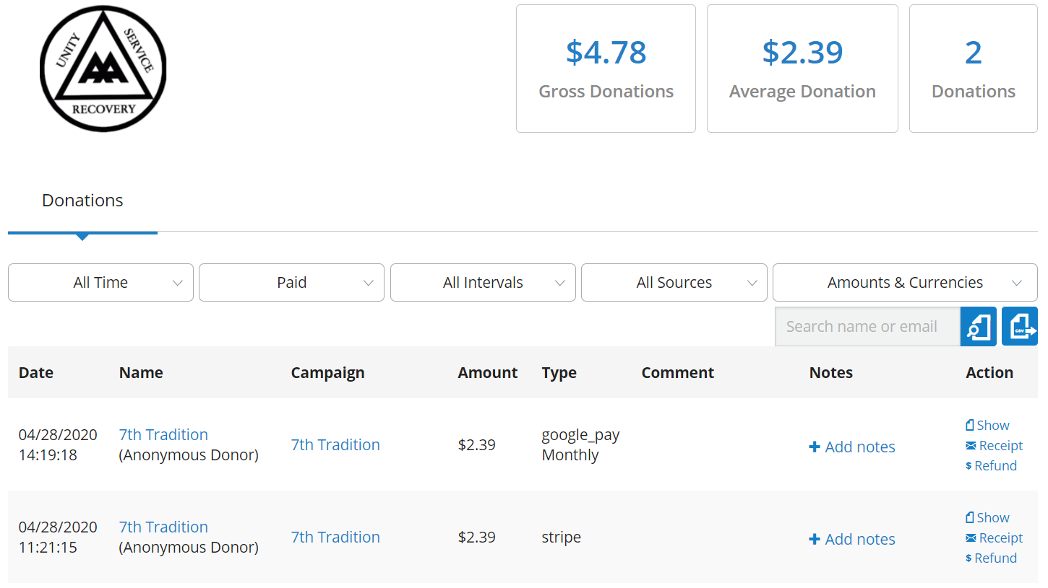
Donorbox.org
D
What It Looks Like
Payment Form
Dashboard

Slide 34
Donorbox.org
D
Summary
Robust choice for longer-term online contributions, especially if you want extra features for payments and contribution tracking:
  Additional customization options could be very beneficial at the District or Area level.
Initial setup is slightly more complicated than PayPal, requiring additional accounts.
Platform is designed for charitable contributions.
  Payment form creation and managing contributions is easier than PayPal.
  Recurring contributions can be set up by credit card, unlike PayPal.
Offers more options to users on mobile.
Standard industry fees apply, plus 1.5% per transaction if over $1,000 in contributions per month.
Offers .8% fee e-check.
  .

Slide 35
Venmo
V
Overview
  Venmo is a “social” mobile payment app, designed for paying friends and family. Also known as “peer-to-peer” payments.
Anonymity Considerations
  Default settings share your payments with “friends” or contacts.
  Easy to break anonymity without realizing it.
  It is simple to change your settings and keep transactions private.
Payment Types
  Credit/Debit.
Ease of Use
  Simple to pay and link with personal accounts.
  Large number of people already use it.
  .
Setup
  Requires a mobile phone number and bank account.
  Terms of service state it cannot be used for charitable contributions, however this does not appear to enforced for group meetings.
  Strongly suggested at a minimum to use a group bank account.
Fees
  No fee to receive money.
  3% fee charged to user for credit cards.
Other Notes
  Rotation of treasurer could be problematic since account is linked to a personal mobile phone.
  Prudence required to use safely.
  .

Slide 36
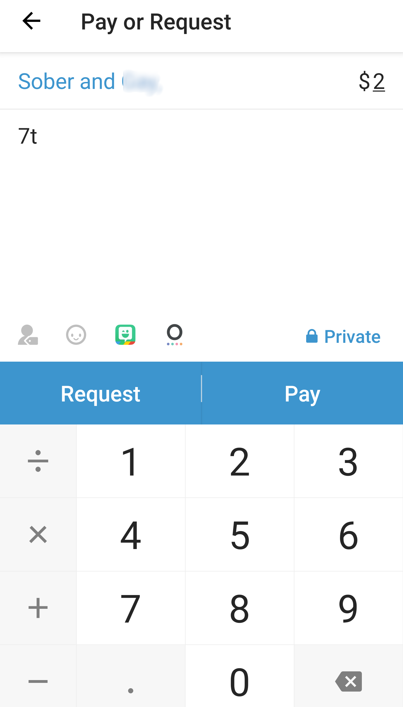
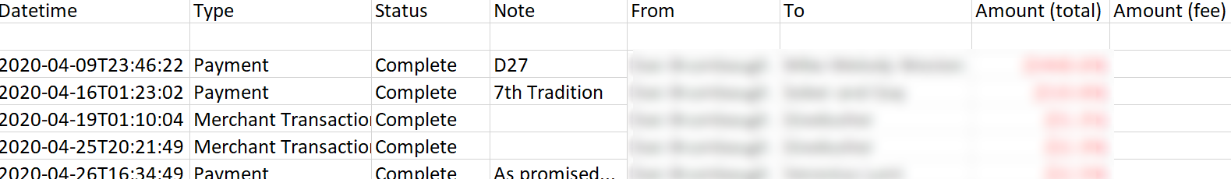
Venmo
V
What It Looks Like
Payment
Transactions

Slide 37
Venmo
V
Summary
Official statements from Venmo say it’s only supposed to be used for payments from friends and family.
Popular and easy to use.
Has more anonymity concerns than other options.
Needs to be linked to a personal mobile number, making it more difficult to use with group accounts.
Groups are using it without issue but...
  .

Slide 38
Cash.App (Square)
C
Overview
  Is a peer-to-peer mobile payment app like Venmo, but without the social feed and its issues.
  .
Anonymity Considerations
  Does not share transactions with “friends” or contacts.
  Your display name can be anonymized.
Payment Types
  Credit/Debit.
Ease of Use
  Simple to pay and link personal accounts.
  Also offers a personalized link or QR code to make payments.
  No more difficult than Venmo.
  .
Setup
  Requires a phone number, but will accept Google Voice, unlike Venmo.
  Can be set up completely with group owned accounts.
Fees
  No fee to receive money.
  3% fee charged to user for credit cards.
Other Notes
  Terms of service make no mention of whether or not charitable contributions are permitted.
  .

Slide 39
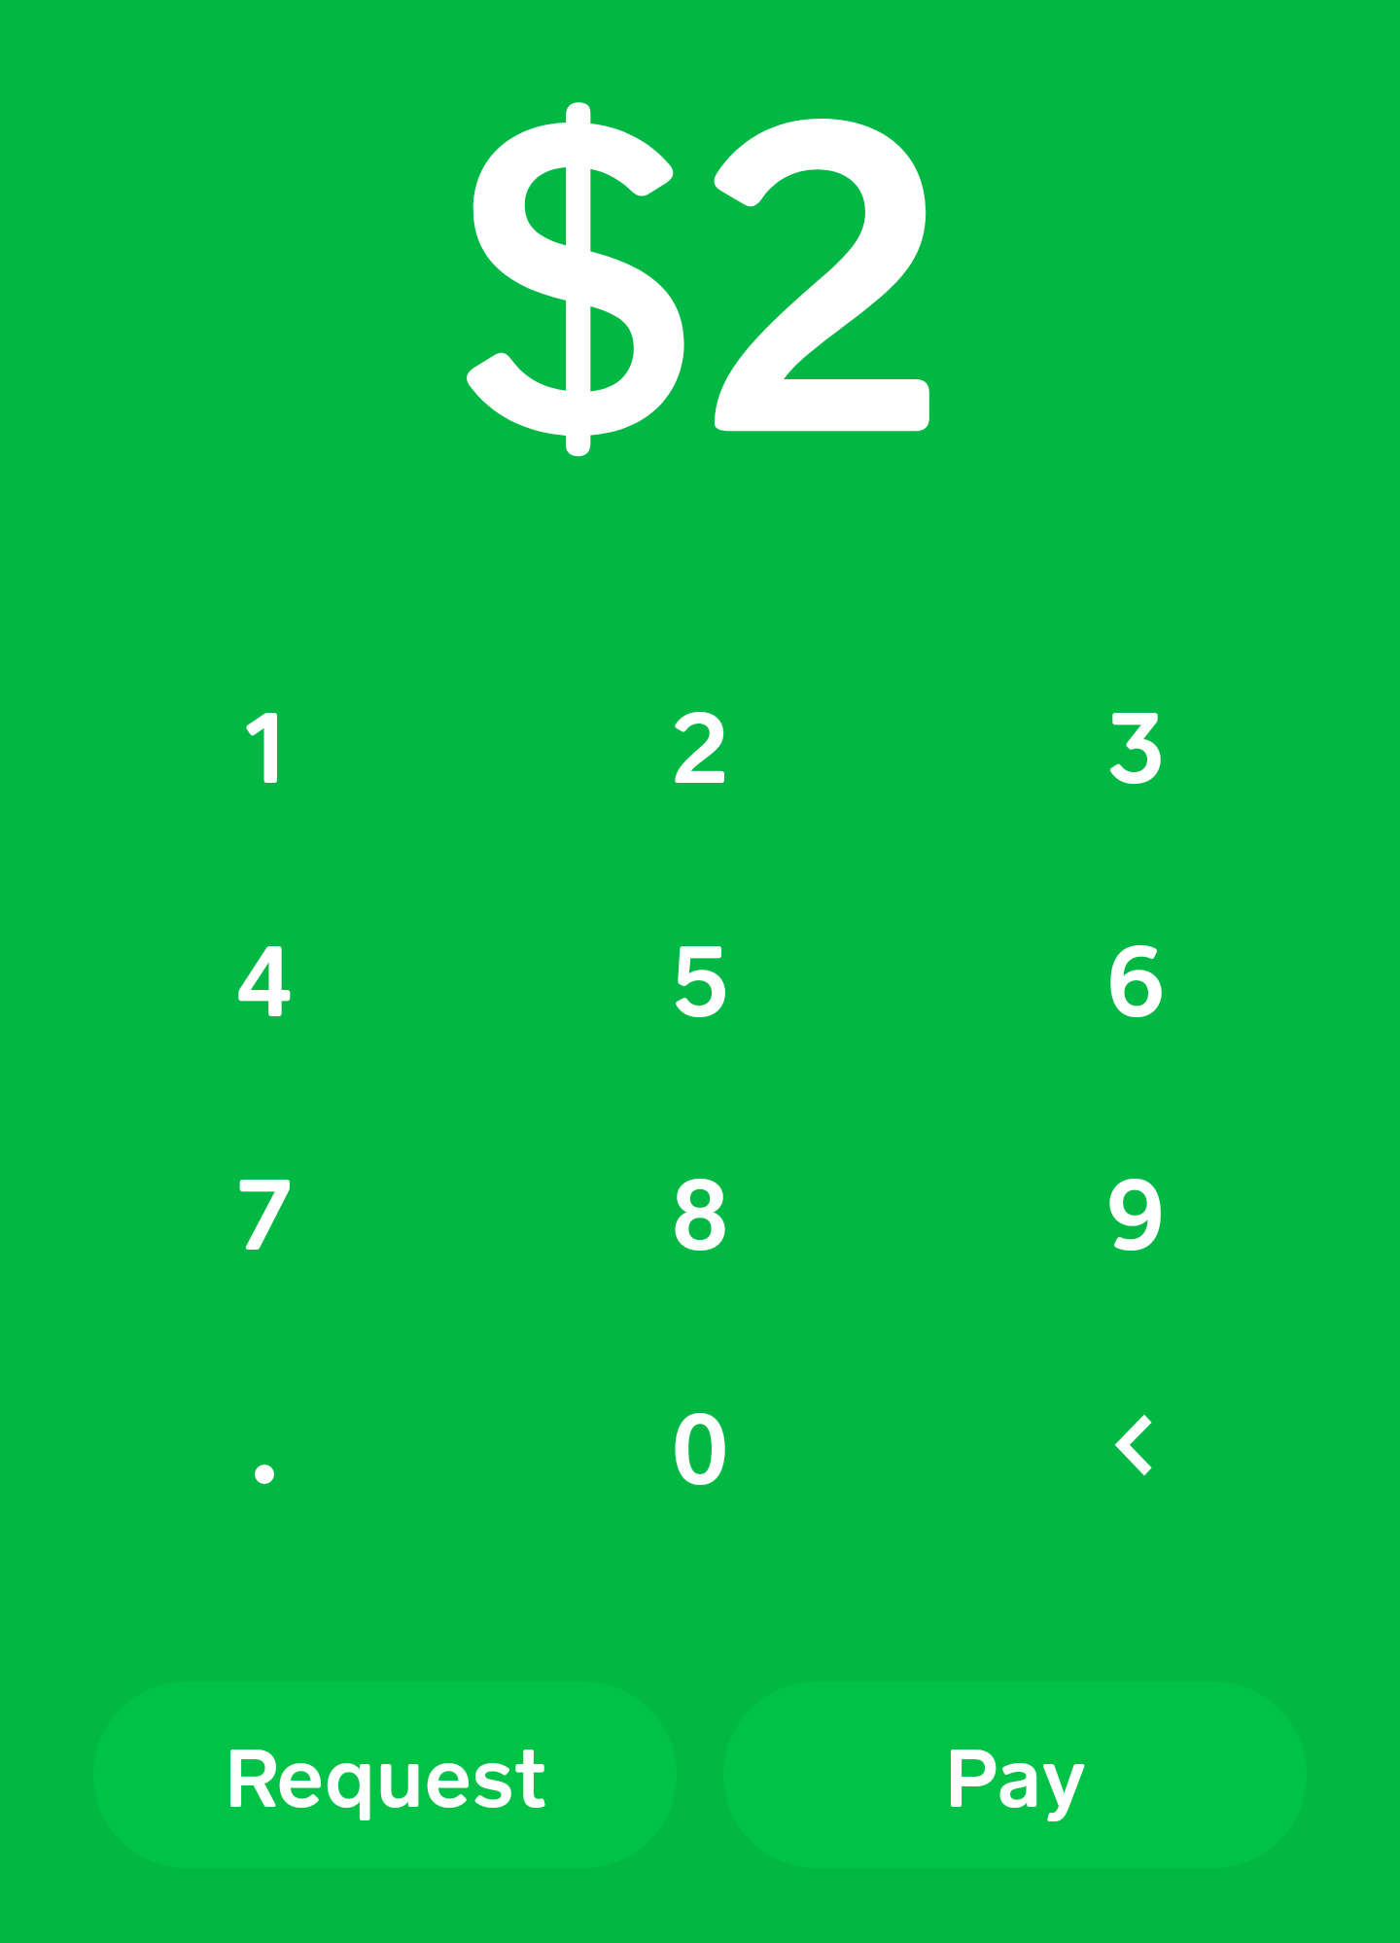
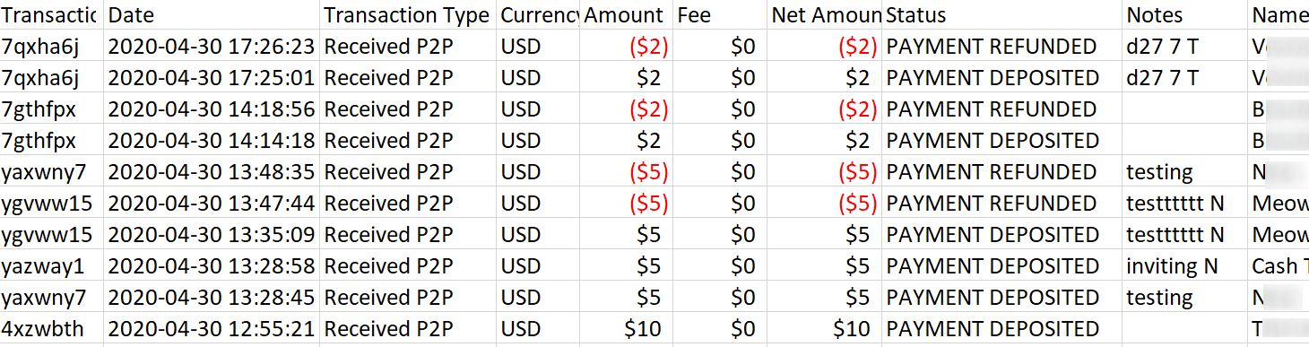
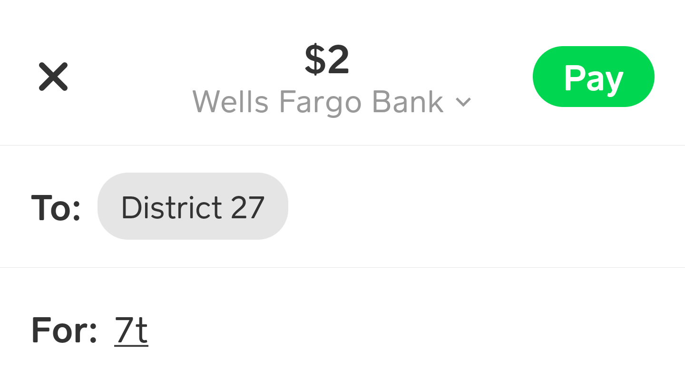
Cash.App
C
What It Looks Like
Payment
Transactions

Slide 40
Cash.App
C
Summary
Not as popular as Venmo, but just as easy to use.
Does not have anonymity concerns of Venmo.
Could be fully used with group owned accounts.
Can be set up quickly.
Can use links or QR codes for one-click payments.
Probably a better choice than Venmo, but...
  .

Slide 41
This chart is to be used only as a starting point for researching digital payments and does not include all possible options.
The Area 59 Finance Subcommittee does NOT suggest, endorse, or recommend any specific payment option.
Digital Platforms
Example Comparison Grid
This is a sample of how groups may want to evaluate different platforms.
Colors represent estimations of differences between platforms during the time of initial research and limited testing.
These are not ratings, but only an example to show some of the many options available.
Each group should reach its own conclusion, only after careful consideration of the points raised in this presentation.
The Area 59 Finance Subcommittee is not endorsing or suggesting which platform any group should choose.
Colors represent subjective estimations of differences between platforms based on limited testing. The comparisons will differ based on your individual situation.

Slide 42

Additional Resources
AA Where Money and Spirituality Mix Pamphlet (F-3)
AA Group Treasurer Pamphlet (F-96)
AA Finance Guidelines (MG-15)
AA Service Manual (BM-31)
aa.org
area59aa.org
SF-Marin Intergroup – Digital 7th Tradition Best Practices

Slide 43




Key Points to Consider
The 7th Tradition is still vital.
Assess the current state of your group finances.
Much to consider before online contributions.
What are the options and how do they compare?

Slide 44

Questions?
Area 59 Finance Subcommittee

